Slide 1
Monday

Slide 2
Course Logistics
Problem Set 3 – Due Wednesday, March 8
PS1 grading complete!
PS2 grading is ongoing…
Project Milestone 2.1 – Overdue!
Grades are released. If you didn’t get 25/25, come talk to me!
Exam 1 – March 13
Review on Friday March 10

Slide 3


And now…
Neural Networks!
Notes:
https://i.pinimg.com/originals/30/5e/08/305e0877c1ade71c70fcd4484aef2d2d.png

Slide 4
Binary Perceptrons – Decision Functions
Binary AND WEIGHTS
1
-1.5
1 | X₁ | X₂ | Output
1 | 0 | 0 | -1
1 | 0 | 1 | -1
1 | 1 | 0 | -1
1 | 1 | 1 | 1
Y₁
+/-
X₁
1
1 or -1
1
X₂

Slide 5
Binary Perceptrons – Decision Functions
Binary OR
1
-0.5
1 | X₁ | X₂ | Output
1 | 0 | 0 | -1
1 | 0 | 1 | 1
1 | 1 | 0 | 1
1 | 1 | 1 | 1
Y₁
X₁
1
1 or -1
1
X₂

Slide 6
Binary Perceptrons – Decision Functions
Binary NAND
1
1.5
1 | X₁ | X₂ | Output
1 | 0 | 0 | 1
1 | 0 | 1 | 1
1 | 1 | 0 | 1
1 | 1 | 1 | -1
Y₁
X₁
-1
1 or -1
-1
X₂

Slide 7
Binary Perceptrons – Decision Functions
After 10,000,000 iterations…
1
-426593
343310
1200
4780
Student | X₁ | X₂ | Y
A | 1200 | 26 | 1
B | 1450 | 28 | 1
C | 1000 | 20 | 1
D | 730 | 15 | -1
NEW | 720 | 16 | ???
1 or -1
-204191
26

Slide 8
Binary Perceptrons – Decision Functions
Binary XOR
1
W₀
1 | X₁ | X₂ | Output
1 | 0 | 0 | -1
1 | 0 | 1 | 1
1 | 1 | 0 | 1
1 | 1 | 1 | -1
Y₁
X₁
W₁
1 or -1
W₂
X₂

Slide 9
Binary Perceptrons – Why Can’t we do XOR?

Slide 10
Binary Perceptrons – Why Can’t we do XOR?
Not a linear decision boundary!

Slide 11
Training our Kernelized Perceptron (Fit)
We no longer have “weights” to train on…
But we can use our Dual Expression of the problem!
∑_{i=1→n} α_{i}y_{i}K(x_{i},x_{j})
And use the same perceptron update as before, but increment our α by 1 each time.
If an example incremented α, then it’s a support vector

Slide 12
Binary Perceptrons – Why Can’t we do XOR?
Not a linear decision boundary!
(We could apply a Kernel, but that process is manual for each problem)

Slide 13
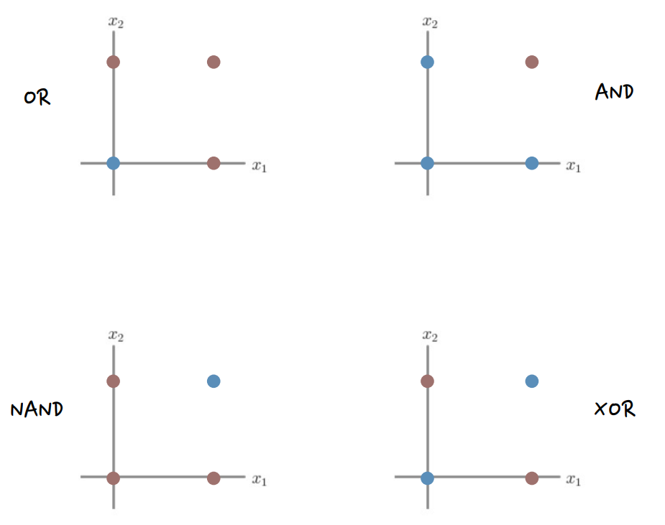

Binary Perceptrons – Why Can’t we do XOR?

Slide 14
Solving our XOR Problem – Multiple Perceptrons
OR Perceptron NAND Perceptron
1
1
0
1.5
Y₁
Y₂
X₁
1
X₁
-1
1 or -1
1 or -1
1
-1
X₂
X₂

Slide 15
Combining Multiple Perceptrons
OR Perceptron NAND Perceptron
1
1
0
1.5
Y₁
Y₂
X₁
1
X₁
-1
1 or -1
1 or -1
1
-1
X₂
X₂

Slide 16
Combining Multiple Perceptrons
1
-0.5
Y₁
X₁
1
1
Y₃
X₂
1 or -1
1
1.5
Y₂
X₁
-1
-1
X₂

Slide 17
Combining Multiple Perceptrons
1
-0.5
A₁
OR
1
1
Y₃
X₁
1 or -1
1.5
-1
A₂ NAND
X₂
-1

Slide 18
Combining Multiple Perceptrons
1
1
-0.5
A₁
OR
1
-1.5
1
Y₃
AND
X₁
1
1 or -1
1.5
1
-1
A₂ NAND
X₂
-1

Slide 19
The Multi-layer Perceptron
INPUT LAYER HIDDEN LAYER OUTPUT LAYER
1
1
A₁
Y₁
X₁
1 or -1
A₂
X₂

Slide 20
The Multi-layer Perceptron
INPUT LAYER HIDDEN LAYER OUTPUT LAYER
1
1
$$b_{1}^{1}$$
$$b_{1}^{2}$$
A₁
Y₁
X₁
$$w_{11}^{1}$$
$$w_{11}^{2}$$
1 or -1
$$w_{21}^{1}$$
$$w_{21}^{2}$$
$$b_{2}^{1}$$
$$w_{12}^{1}$$
A₂
X₂
$$w_{22}^{1}$$

Slide 21

The Multi-layer Perceptron
Layer
$$w_{12}^{1}$$
Output
From
Current
Layer
Input
To
Next
Layer
INPUT LAYER HIDDEN LAYER OUTPUT LAYER
1
1
$$b_{1}^{1}$$
$$b_{1}^{2}$$
A₁
Y₁
X₁
$$w_{11}^{1}$$
$$w_{11}^{2}$$
1 or -1
$$w_{21}^{1}$$
$$w_{21}^{2}$$
$$b_{2}^{1}$$
$$w_{12}^{1}$$
A₂
X₂
$$w_{22}^{1}$$

Slide 22
The Multi-layer Perceptron
INPUT LAYER HIDDEN LAYER OUTPUT LAYER
Intermediate Activities z
$$z_{1}=w_{11}^{1}x_{1}+w_{21}^{1}x_{2}+b_{1}^{1}$$
$$z_{2}=w_{12}^{1}x_{1}+w_{22}^{1}x_{2}+b_{2}^{1}$$
Intermediate Activations a
1
1
$$b_{1}^{1}$$
$$b_{1}^{2}$$
a₁
Y₁
X₁
$$w_{11}^{1}$$
$$w_{11}^{2}$$
1 or -1
$$w_{21}^{1}$$
$$w_{21}^{2}$$
$$b_{2}^{1}$$
$$w_{12}^{1}$$
a₂
X₂
$$w_{22}^{1}$$

Slide 23
The Multi-layer Perceptron
INPUT LAYER HIDDEN LAYER OUTPUT LAYER
$$W^{1}=\left[\begin{matrix}w_{11}^{1} & w_{12}^{1} \\ w_{21}^{1} & w_{22}^{1}\end{matrix}\right], b^{1}=\left[\begin{matrix}b_{1}^{1} \\ b_{2}^{1}\end{matrix}\right]$$
Intermediate Activities z
$$z^{2}=W^{1}x^{1}+b^{1}$$
Intermediate Activations a
1
1
$$b_{1}^{1}$$
$$b_{1}^{2}$$
a₁
Y₁
X₁
$$w_{11}^{1}$$
$$w_{11}^{2}$$
1 or -1
$$w_{21}^{1}$$
$$w_{21}^{2}$$
$$b_{2}^{1}$$
$$w_{12}^{1}$$
a₂
X₂
$$w_{22}^{1}$$

Slide 24
The Multi-layer Perceptron
Current Layer Outgoing
INPUT LAYER HIDDEN LAYER OUTPUT LAYER
$$W^{1}=\left[\begin{matrix}w_{11}^{1} & w_{12}^{1} \\ w_{21}^{1} & w_{22}^{1}\end{matrix}\right], b^{1}=\left[\begin{matrix}b_{1}^{1} \\ b_{2}^{1}\end{matrix}\right]$$
Intermediate Activities z
$$z^{2}=W^{1}x^{1}+b^{1}$$
Intermediate Activations a
1
1
$$b_{1}^{1}$$
$$b_{1}^{2}$$
a₁
Y₁
X₁
$$w_{11}^{1}$$
$$w_{11}^{2}$$
1 or -1
$$w_{21}^{1}$$
$$w_{21}^{2}$$
$$b_{2}^{1}$$
$$w_{12}^{1}$$
a₂
X₂
$$w_{22}^{1}$$

Slide 25
The Multi-layer Perceptron
Next Layer Incoming
INPUT LAYER HIDDEN LAYER OUTPUT LAYER
$$W^{1}=\left[\begin{matrix}w_{11}^{1} & w_{12}^{1} \\ w_{21}^{1} & w_{22}^{1}\end{matrix}\right], b^{1}=\left[\begin{matrix}b_{1}^{1} \\ b_{2}^{1}\end{matrix}\right]$$
Intermediate Activities z
$$z^{2}=W^{1}x^{1}+b^{1}$$
Intermediate Activations a
1
1
$$b_{1}^{1}$$
$$b_{1}^{2}$$
a₁
Y₁
X₁
$$w_{11}^{1}$$
$$w_{11}^{2}$$
1 or -1
$$w_{21}^{1}$$
$$w_{21}^{2}$$
$$b_{2}^{1}$$
$$w_{12}^{1}$$
a₂
X₂
$$w_{22}^{1}$$

Slide 26
The Multi-layer Perceptron
INPUT LAYER HIDDEN LAYER OUTPUT LAYER
$$W^{2}=\left[\begin{matrix}w_{11}^{2} & w_{21}^{2}\end{matrix}\right], b^{1}=\left[b_{1}^{2}\right]$$
Intermediate Activities z
$$z^{3}=W^{2}a^{2}+b^{2}$$
Final Activations y
+ / -
1
1
$$b_{1}^{1}$$
$$b_{1}^{2}$$
a₁
Y₁
X₁
$$w_{11}^{1}$$
$$w_{11}^{2}$$
1 or -1
$$w_{21}^{1}$$
$$w_{21}^{2}$$
$$b_{2}^{1}$$
$$w_{12}^{1}$$
a₂
X₂
$$w_{22}^{1}$$

Slide 27
Combining Multiple Perceptrons
1
1
$$W^{1}=\left[\begin{matrix}w_{11}^{1} & w_{12}^{1} \\ w_{21}^{1} & w_{22}^{1}\end{matrix}\right], b^{1}=\left[\begin{matrix}b_{1}^{1} \\ b_{2}^{1}\end{matrix}\right]$$
Intermediate Activities z
$$z^{2}=W^{1}x^{1}+b^{1}$$
Intermediate Activations a
0
A₁
OR
1
-1.5
1
Y₃
AND
X₁
1
1 or -1
1.5
1
-1
A₂ NAND
X₂
-1

Slide 28
Combining Multiple Perceptrons
1
1
$$W^{2}=\left[\begin{matrix}w_{11}^{2} & w_{11}^{2}\end{matrix}\right], b^{1}=\left[b_{1}^{2}\right]$$
Intermediate Activities z
$$z^{3}=W^{2}a^{2}+b^{2}$$
Final Activations y
0
A₁
OR
1
-1.5
1
1
Y₃
AND
X₁
1 or -1
1.5
1
-1
A₂ NAND
X₂
-1

Slide 29
Generalizing Beyond The Perceptron
What comes in to a decision point?
How the decision point makes a decision?
What comes out of a decision point?

Slide 30
Adding & Removing Connections
INPUT LAYER HIDDEN LAYER OUTPUT LAYER
1
1
$$b_{1}^{1}$$
$$b_{1}^{2}$$
A₁
Y₁
X₁
$$w_{11}^{1}$$
$$w_{11}^{2}$$
1 or -1
$$w_{21}^{1}$$
$$w_{21}^{2}$$
$$b_{2}^{1}$$
$$w_{12}^{1}$$
A₂
X₂
$$w_{22}^{1}$$

Slide 31
Adding & Removing Connections
INPUT LAYER HIDDEN LAYER OUTPUT LAYER
1
1
$$b_{1}^{1}$$
$$b_{1}^{2}$$
A₁
Y₁
X₁
$$w_{11}^{1}$$
$$w_{11}^{2}$$
1 or -1
$$w_{21}^{1}$$
$$w_{21}^{2}$$
$$b_{2}^{1}$$
$$w_{12}^{1}$$
A₂
X₂
X₃
$$w_{22}^{1}$$

Slide 32
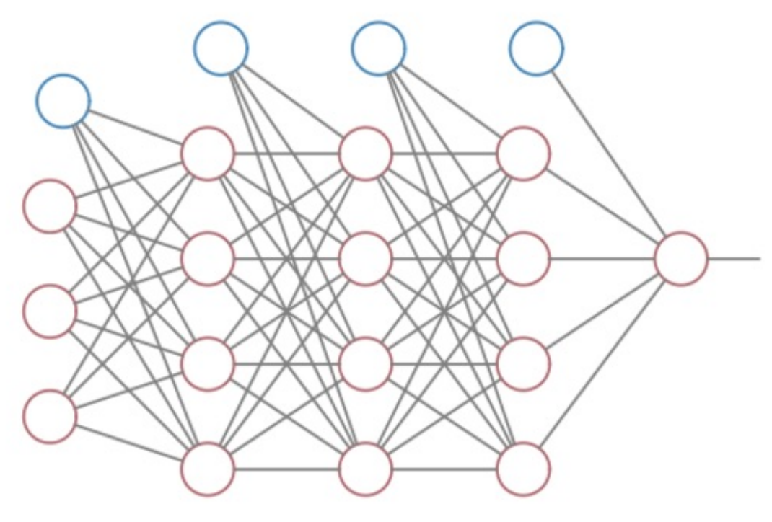
Neural Networks!
Data Input Layer
Hidden Layer(s)
Output Layer

Slide 33
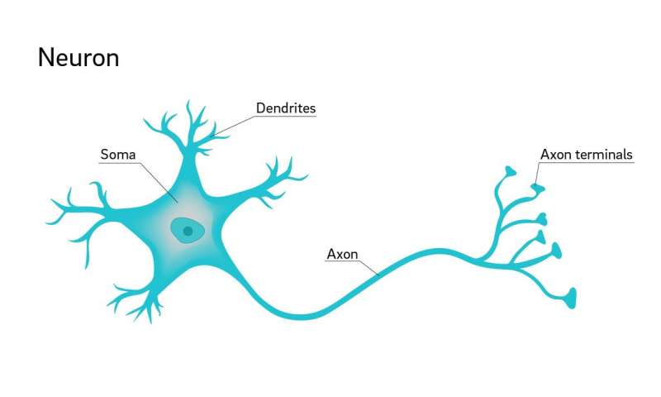
Interlude – the Neuron
Dendrites receive
electrical input from
other cells
Soma combines input,
produces output on axon
Axon connects to other
Neurons (@ dendrites)

Slide 34
Neural Networks!
Data Input Layer
Hidden Layer(s)
Output Layer

Slide 35
Generalizing Beyond The Perceptron
What comes in to a decision point?
How the decision point makes a decision?
What comes out of a decision point?

Slide 36
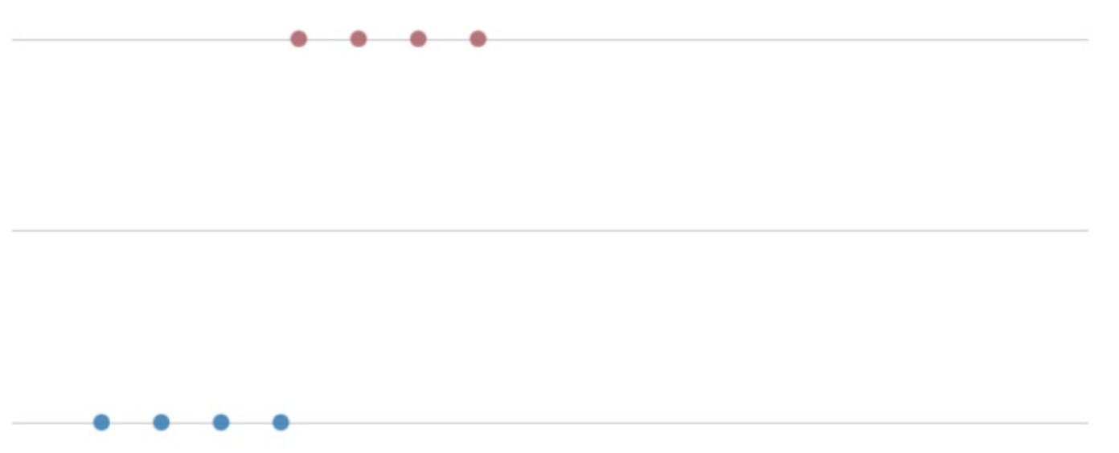

Perceptron – Week 2
1 – Bulldog
0 - ~Bulldog
Slobber (ml)
Perceptron if x > 50 ml, y = 1
else, y = 0

Slide 37
Perceptron – Week 2
1 – Bulldog
0 - ~Bulldog
Slobber (ml)
Perceptron if x > 50 ml, y = 1
else, y = 0
1
$$−50$$
Y₁
X₁
1
1 or -1

Slide 38
Generalizing Beyond The Perceptron
What comes in to a decision point?
- any number of entries
- any possible values
How the decision point makes a decision?
What comes out of a decision point?

Slide 39
Perceptron – Outputs
1
$$−50$$
Y₁
X₁
1
1 or -1

Slide 40
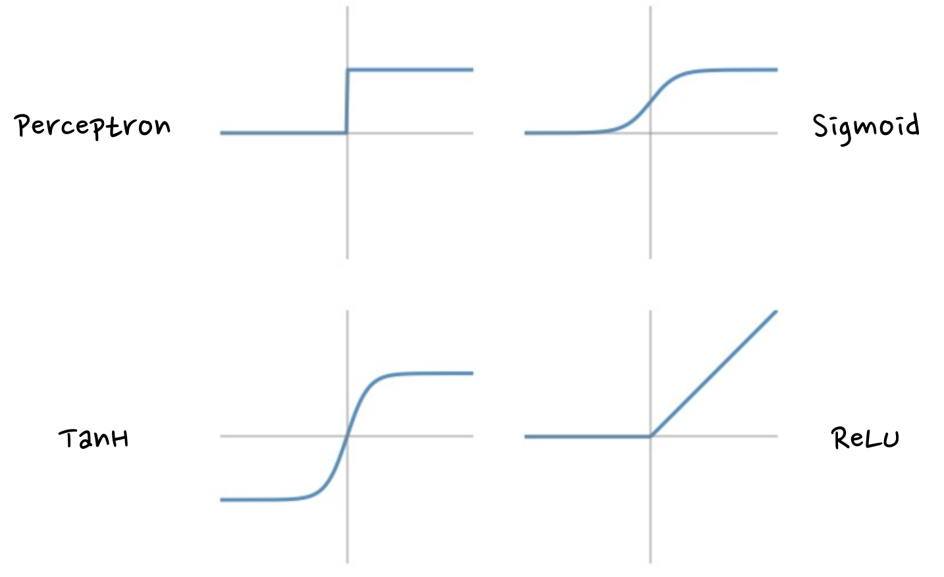

Decision Boundaries
Any decision
Function
ReLU – Rectified
linear unit,
Max(0,z)

Slide 41
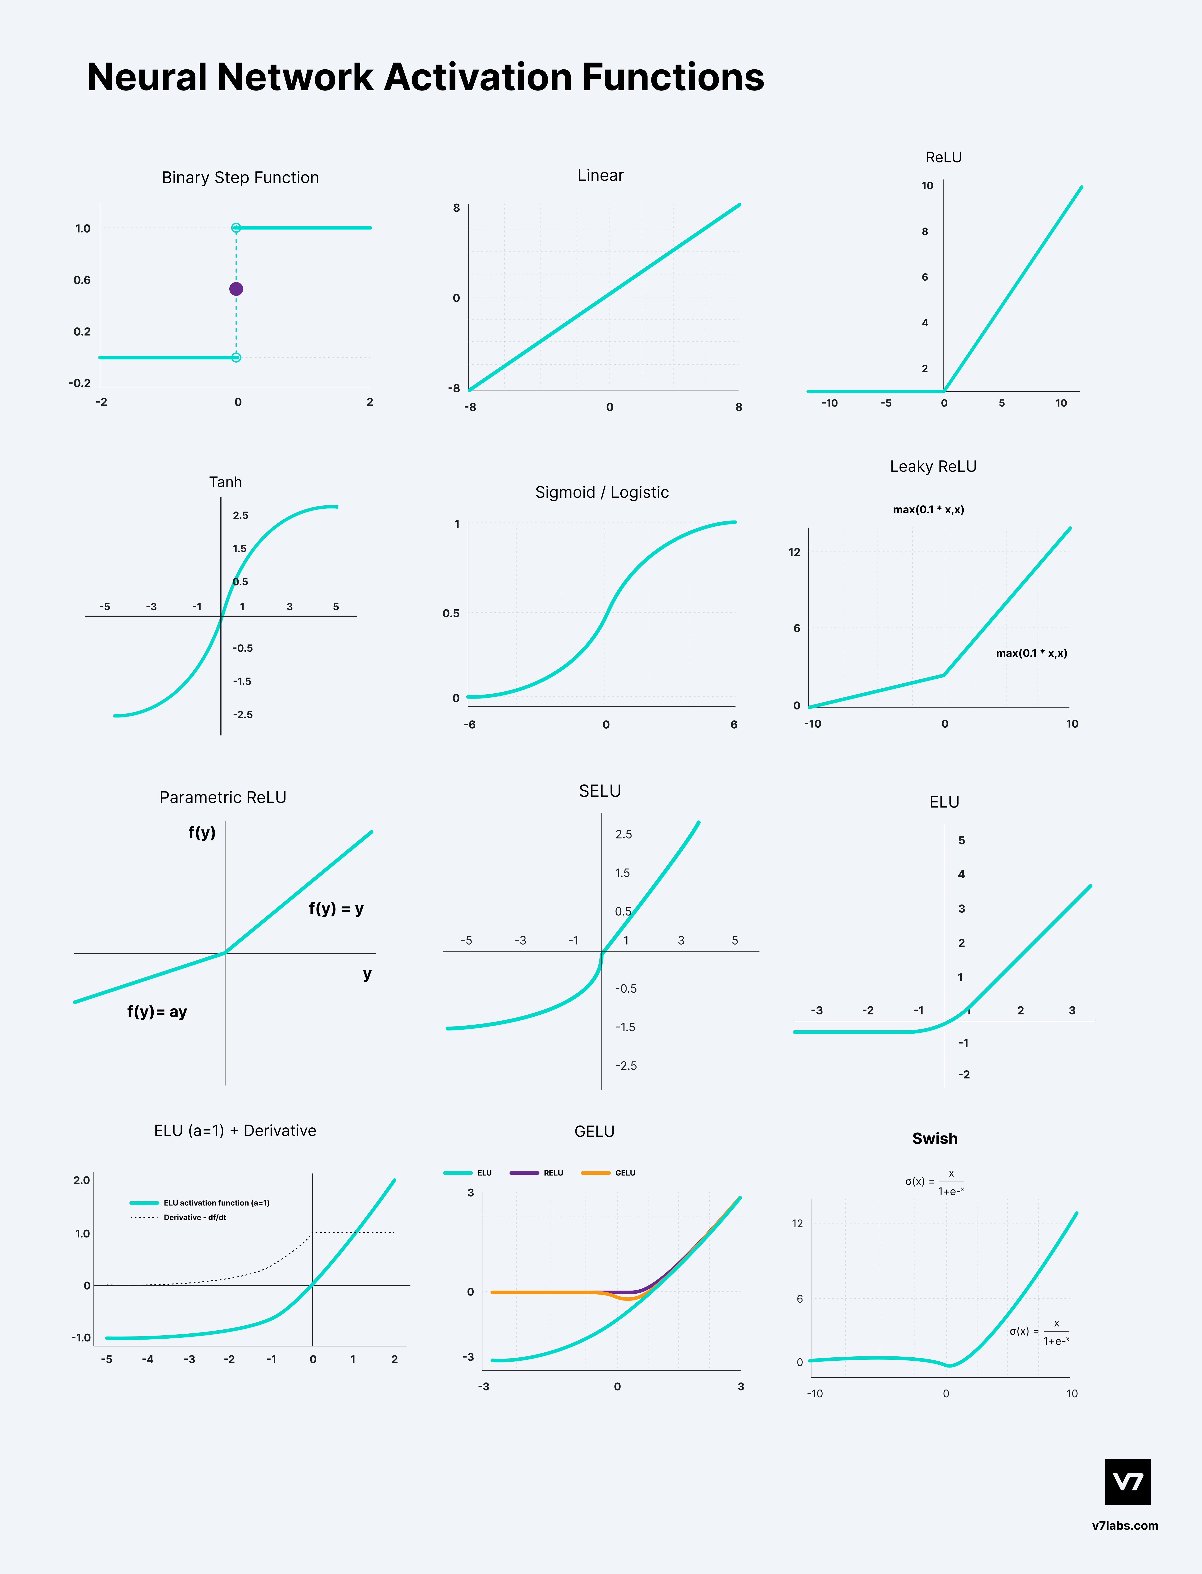
Decision Boundaries
https://www.v7labs.com/blog/neural-networks-activation-functions

Slide 42
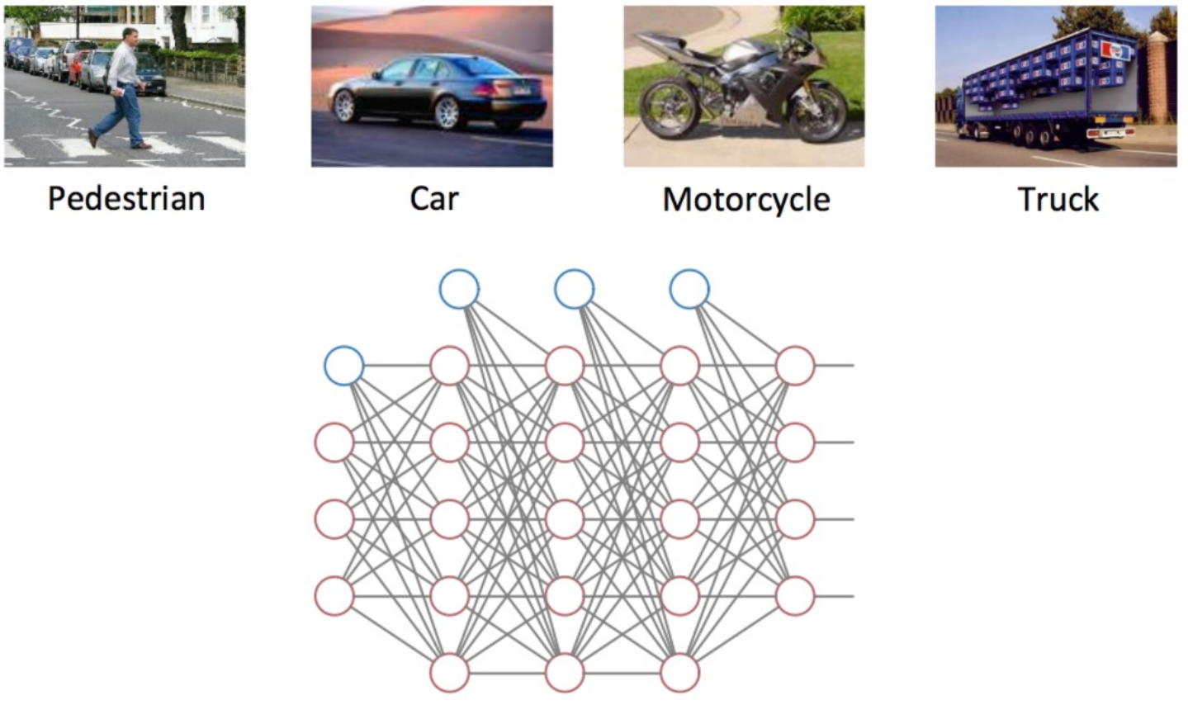
Neural Network Outputs – Beyond Binary

Slide 43
Neural Network Outputs – Beyond Binary

Slide 44
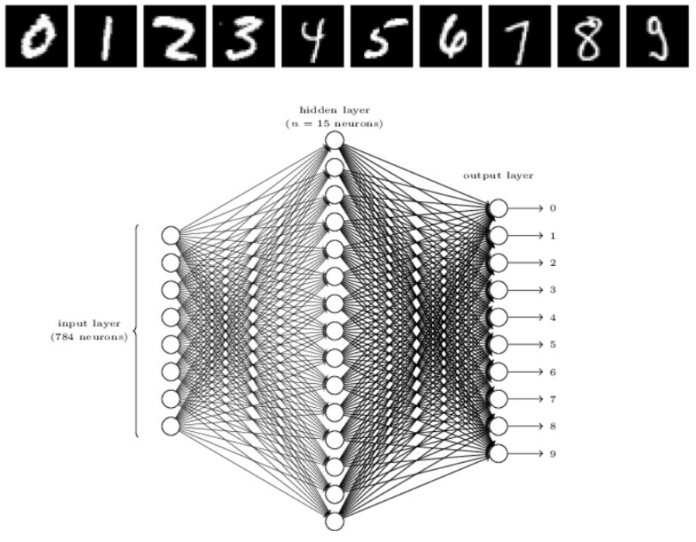
Neural Networks

Slide 45
Neural Networks!
Data Input Layer
Hidden Layer(s)
Output Layer

Slide 46
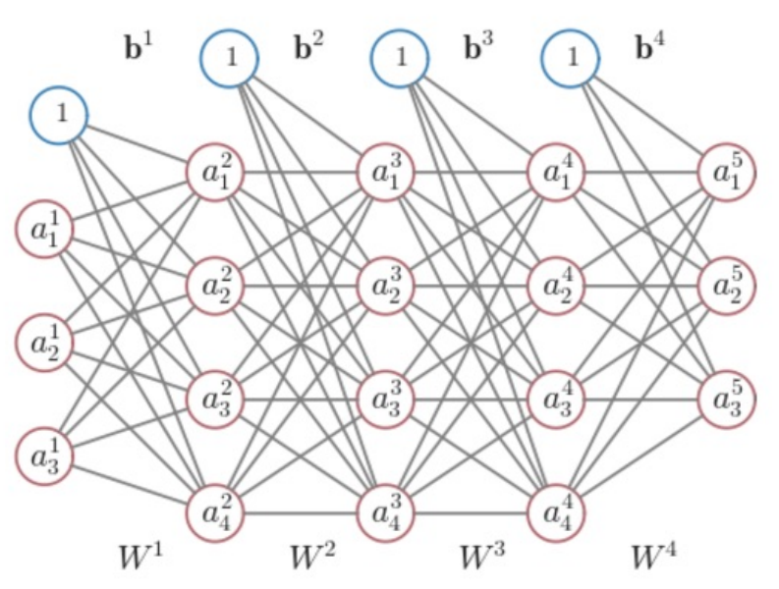
Neural Networks - Notation
$$l=layer (from 1 to L)$$
$$b^{l}=vector of bias inputs for l+1$$
$$b_{i}^{l}=bias value, layer l, node i$$
$$W^{l}=matrix of weights for l+1$$
$$w_{ji}^{l}=weigh value, layer l, nodes j to i$$

Slide 47
Neural Networks - Notation
$$l=layer (from 1 to L)$$
$$b^{l}=vector of bias inputs for l+1$$
$$b_{i}^{l}=bias value, layer l, node i$$
$$W^{l}=matrix of weights for l+1$$
$$w_{ji}^{l}=weigh value, layer l, nodes j to i$$
$$z^{l+1}=W^{l}a^{l}+b^{l}$$
$$a^{l+1}=g(z^{l+1})$$
ŷ = a^{L}

Slide 48
Neural Networks – Learning the Weights
Define a Loss Function $C\left(x,y,W,b\right)$
$$Classification=−\sum_{k=1}^{m}{y_{k}\log\left({\hat{y}}_{k}\right)+\left(1 −y_{k}\right)\log\left(1−{\hat{y}}_{k}\right)}$$
$$Regression=\frac{1}{2}\sum_{k=1}^{m}{{(y}_{k}−{\hat{y}}_{k})2}$$

Slide 49
Neural Networks – Learning the Weights
Gradient Descent!

Slide 50
Neural Networks – Learning the Weights
Gradient Descent!
$w_{ij}^{l}$ = $w_{ij}^{l}−\text{η}\frac{∂C}{∂w_{ji}^{l}}$
$b_{i}^{l}$ = $b_{i}^{l}−\text{η}\frac{∂C}{∂b_{i}^{l}}$

Slide 51
Neural Networks – Learning the Weights
Gradient Descent!
$w_{ij}^{l}$ = $w_{ij}^{l}−\text{η}\frac{∂C}{∂w_{ji}^{l}}$
$b_{i}^{l}$ = $b_{i}^{l}−\text{η}\frac{∂C}{∂b_{i}^{l}}$

Slide 52
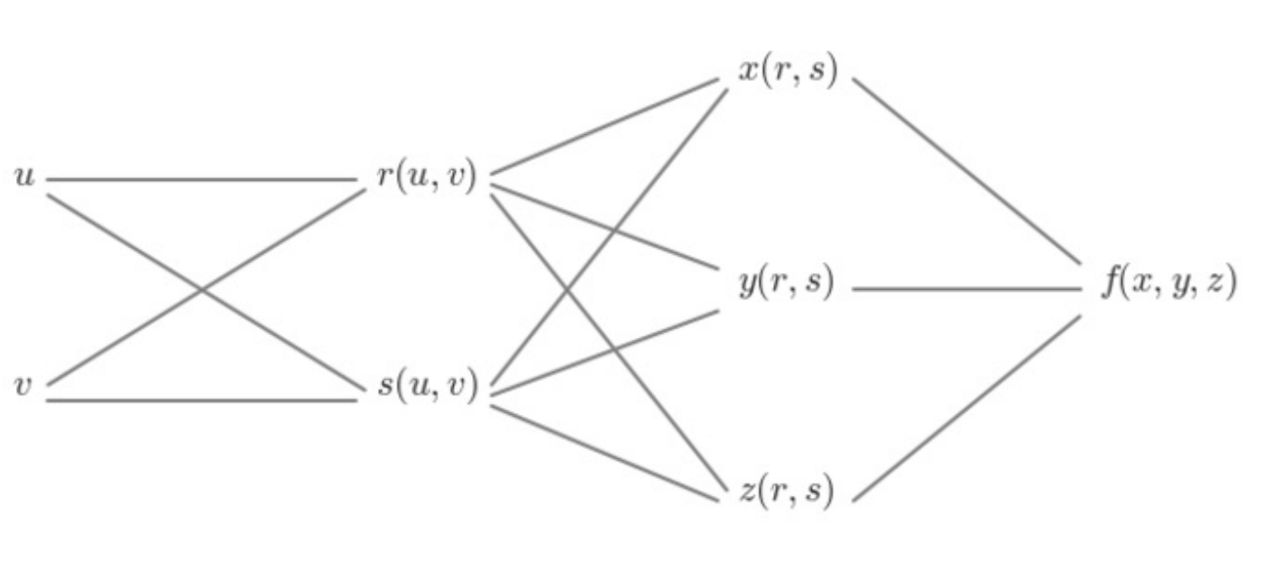

Computing the Partial Derivatives
$$derivative of f with respect to x= \frac{∂f}{∂x}$$

Slide 53
Computing the Partial Derivatives
$$derivative of f with respect to y= \frac{∂f}{∂y}$$

Slide 54

Computing the Partial Derivatives
$$derivative of f with respect to z= \frac{∂f}{∂z}$$

Slide 55

Computing the Partial Derivatives
$$derivative of f with respect to r=???$$

Slide 56
Neural Networks – Learning the Weights
Gradient Descent!
$w_{ij}^{l}$ = $w_{ij}^{l}−\text{η}\frac{∂C}{∂w_{ji}^{l}}$
$b_{i}^{l}$ = $b_{i}^{l}−\text{η}\frac{∂C}{∂b_{i}^{l}}$
This becomes intractable!

Slide 57
Overcoming Gradient Descent Problems
Resolving derivatives of nested functions using The Chain Rule

Slide 58
Overcoming Gradient Descent Problems
Resolving derivatives of nested functions using The Chain Rule
The Chain Rule (Calculus ???)
$$\frac{d}{dx}f\left(g\left(x\right)\right)=f^{′}\left(g\left(x\right)\right)g^{′}\left(x\right)= \frac{df}{dg}\frac{dg}{dx}$$

Slide 59
Computing the Partial Derivatives
$$derivative of f with respect to r=???$$

Slide 60
Computing the Partial Derivatives
$$derivative of f with respect to r=???$$
$$\frac{∂f}{∂r}=\frac{∂f}{∂x}\frac{∂x}{∂r}+\frac{∂f}{∂y}\frac{∂y}{∂r}+\frac{∂f}{∂z}\frac{∂z}{∂r}$$

Slide 61
Computing the Partial Derivatives
$$derivative of f with respect to s=???$$

Slide 62
Computing the Partial Derivatives
$$derivative of f with respect to s=???$$
$$\frac{∂f}{∂s}=\frac{∂f}{∂x}\frac{∂x}{∂s}+\frac{∂f}{∂y}\frac{∂y}{∂s}+\frac{∂f}{∂z}\frac{∂z}{∂s}$$

Slide 63

Computing the Partial Derivatives - Practice
$$derivative of f with respect to s=\frac{∂f}{∂s}=\frac{∂f}{∂x}\frac{∂x}{∂s}+\frac{∂f}{∂y}\frac{∂y}{∂s}+\frac{∂f}{∂z}\frac{∂z}{∂s}$$
Given…
$$f=xyz$$
$$x=r$$
$$y=rs$$
$$z=s$$
$$\frac{∂f}{∂s}= ?$$

Slide 64
Computing the Partial Derivatives - Practice
$$derivative of f with respect to s=\frac{∂f}{∂s}=\frac{∂f}{∂x}\frac{∂x}{∂s}+\frac{∂f}{∂y}\frac{∂y}{∂s}+\frac{∂f}{∂z}\frac{∂z}{∂s}$$
Given…
$$f=xyz$$
$$x=r$$
$$y=rs$$
$$z=s$$
$$\frac{∂f}{∂s}=yz∗0+xz ∗r+xy ∗1$$

Slide 65
Computing the Partial Derivatives - Practice
$$derivative of f with respect to s=\frac{∂f}{∂s}=\frac{∂f}{∂x}\frac{∂x}{∂s}+\frac{∂f}{∂y}\frac{∂y}{∂s}+\frac{∂f}{∂z}\frac{∂z}{∂s}$$
Given…
$$f=xyz$$
$$x=r$$
$$y=rs$$
$$z=s$$
$$\frac{∂f}{∂s}=yz∗0+xz ∗r+xy ∗1$$

Slide 66
Computing the Partial Derivatives - Practice
$$derivative of f with respect to s=\frac{∂f}{∂s}=\frac{∂f}{∂x}\frac{∂x}{∂s}+\frac{∂f}{∂y}\frac{∂y}{∂s}+\frac{∂f}{∂z}\frac{∂z}{∂s}$$
$$f=xyz$$
$$x=r$$
$$y=rs$$
$$z=s$$
$$\frac{∂f}{∂s}=yz∗0+xz∗r+xy ∗1$$

Slide 67
Computing the Partial Derivatives - Practice
$$derivative of f with respect to s=\frac{∂f}{∂s}=\frac{∂f}{∂x}\frac{∂x}{∂s}+\frac{∂f}{∂y}\frac{∂y}{∂s}+\frac{∂f}{∂z}\frac{∂z}{∂s}$$
$$f=xyz$$
$$x=r$$
$$y=rs$$
$$z=s$$
$$\frac{∂f}{∂s}=yz∗0+xz∗r+xy ∗1$$
$$\frac{∂f}{∂s}=rs^{2}∗0+rs∗r+r^{2}s ∗1$$

Slide 68
Computing the Partial Derivatives - Practice
$$derivative of f with respect to s=\frac{∂f}{∂s}=\frac{∂f}{∂x}\frac{∂x}{∂s}+\frac{∂f}{∂y}\frac{∂y}{∂s}+\frac{∂f}{∂z}\frac{∂z}{∂s}$$
$$f=xyz$$
$$x=r$$
$$y=rs$$
$$z=s$$
$$\frac{∂f}{∂s}=yz∗0+xz∗r+xy ∗1$$
$$\frac{∂f}{∂s}=rs^{2}∗0+rs∗r+r^{2}s ∗1$$
$$\frac{∂f}{∂s}=2r^{2}s$$

Slide 69
Computing the Partial Derivatives - Practice
$$derivative of f with respect to s=\frac{∂f}{∂s}=\frac{∂f}{∂x}\frac{∂x}{∂s}+\frac{∂f}{∂y}\frac{∂y}{∂s}+\frac{∂f}{∂z}\frac{∂z}{∂s}$$
$$f=xyz$$
$$x=r$$
$$y=rs$$
$$z=s$$
$$f\left(r,s\right)=r ∗rs ∗s=r^{2}s^{2}$$
$$\frac{∂f}{∂s}=2r^{2}s$$

Slide 70
Computing the Partial Derivatives
$$derivative of f with respect to u=???$$

Slide 71
Computing the Partial Derivatives
$$derivative of f with respect to u=$$
$$\frac{∂f}{∂x}\frac{∂x}{∂r}\frac{∂r}{∂u}+\frac{∂f}{∂y}\frac{∂y}{∂r}\frac{∂r}{∂u}+\frac{∂f}{∂z}\frac{∂z}{∂r}\frac{∂r}{∂u}+\frac{∂f}{∂x}\frac{∂x}{∂s}\frac{∂s}{∂u}+\frac{∂f}{∂y}\frac{∂y}{∂s}\frac{∂s}{∂u}+\frac{∂f}{∂z}\frac{∂z}{∂s}\frac{∂s}{∂u}$$

Slide 72
Computing the Partial Derivatives
$$derivative of f with respect to u=$$
$$\left(\frac{∂f}{∂x}\frac{∂x}{∂r}+\frac{∂f}{∂y}\frac{∂y}{∂r}+\frac{∂f}{∂z}\frac{∂z}{∂r}\right)\frac{∂r}{∂u}+\left(\frac{∂f}{∂x}\frac{∂x}{∂s}+\frac{∂f}{∂y}\frac{∂y}{∂s}+\frac{∂f}{∂z}\frac{∂z}{∂s}\right)\frac{∂s}{∂u}$$

Slide 73
Computing the Partial Derivatives
$$derivative of f with respect to u=$$
$$\frac{∂f}{∂r}\frac{∂r}{∂u}+\frac{∂f}{∂s}\frac{∂s}{∂u}$$

Slide 74
Computing the Partial Derivatives
Chain Rule
If you know the derivative in terms of an intermediate value, you can skip the items in-between!

Slide 75
Back Propagation
1
1
b¹
b²
Y₁
X₁
C(Y₁,Y₂)
Y₂
X₂
a¹
W¹
W²
z³|a³
z²|a²

Slide 76
Back Propagation
Derivatives of C w.r.t Weights, biases
$$\frac{∂C}{∂w_{ij}^{l}},\frac{∂C}{∂b_{i}^{l}}for l=1, 2$$
1
1
b¹
b²
Y₁
X₁
C(Y₁,Y₂)
Y₂
X₂
a¹
W¹
W²
z³|a³
z²|a²

Slide 77
Back Propagation
Derivatives of C w.r.t Weights, biases
Find our intermediate values (z^{l} or a^{l})
(z is going to work easier)
1
1
b¹
b²
Y₁
X₁
C(Y₁,Y₂)
Y₂
X₂
a¹
W¹
W²
z³|a³
z²|a²

Slide 78
Back Propagation
Derivatives of C w.r.t Weights, biases
$${\text{δ}}_{i}^{l}=\frac{∂C}{∂w_{ij}^{l}}, {\text{δ}}^{l} vector quantity$$
1
1
b¹
b²
Y₁
X₁
C(Y₁,Y₂)
Y₂
X₂
a¹
W¹
W²
z³|a³
z²|a²

Slide 79
Back Propagation
$${\text{δ}}_{i}^{3}=\frac{∂C}{∂z_{i}^{3}}=\frac{∂C}{∂a_{i}^{3}}\frac{∂a_{i}^{3}}{∂z_{i}^{3}}$$
Where i = 1, 2
1
1
b¹
b²
Y₁
X₁
C(Y₁,Y₂)
Y₂
X₂
a¹
W¹
W²
z³|a³
z²|a²

Slide 80
Back Propagation
$${\text{δ}}_{i}^{3}=\frac{∂C}{∂z_{i}^{3}}=\frac{∂C}{∂a_{i}^{3}}\frac{∂a_{i}^{3}}{∂z_{i}^{3}}, i=1,2$$
Let’s clean this up

Slide 81
Decision Boundaries
https://www.v7labs.com/blog/neural-networks-activation-functions

Slide 82
The Multi-layer Perceptron
INPUT LAYER HIDDEN LAYER OUTPUT LAYER
$$W^{1}=\left[\begin{matrix}w_{11}^{1} & w_{12}^{1} \\ w_{21}^{1} & w_{22}^{1}\end{matrix}\right], b^{1}=\left[\begin{matrix}b_{1}^{1} \\ b_{2}^{1}\end{matrix}\right]$$
Intermediate Activities z
$$z^{2}=W^{1}x^{1}+b^{1}$$
Intermediate Activations a
$$a^{2}=g(z^{2})$$
1
1
$$b_{1}^{1}$$
$$b_{1}^{2}$$
a₁
Y₁
X₁
$$w_{11}^{1}$$
$$w_{11}^{2}$$
1 or -1
$$w_{21}^{1}$$
$$w_{21}^{2}$$
$$b_{2}^{1}$$
$$w_{12}^{1}$$
a₂
X₂
$$w_{22}^{1}$$

Slide 83
Back Propagation
$${\text{δ}}_{i}^{3}=\frac{∂C}{∂z_{i}^{3}}=\frac{∂C}{∂a_{i}^{3}}\frac{∂a_{i}^{3}}{∂z_{i}^{3}}, i=1,2$$
$a_{i}^{3}=g(z_{i}^{3})$, so $\frac{∂a_{i}^{3}}{∂z_{i}^{3}}=g′(z_{i}^{3})$

Slide 84
Back Propagation
$${\text{δ}}_{i}^{3}=\frac{∂C}{∂z_{i}^{3}}=\frac{∂C}{∂a_{i}^{3}}\frac{∂a_{i}^{3}}{∂z_{i}^{3}}, i=1,2$$
$${\text{δ}}_{i}^{3}=\frac{∂C}{∂z_{i}^{3}}=\frac{∂C}{∂a_{i}^{3}}g′(z_{i}^{3}), i=1,2$$

Slide 85
Computing the Partial Derivatives
$$derivative of f with respect to x= \frac{∂f}{∂x}$$

Slide 86
Back Propagation
$${\text{δ}}_{i}^{3}=\frac{∂C}{∂z_{i}^{3}}=\frac{∂C}{∂a_{i}^{3}}\frac{∂a_{i}^{3}}{∂z_{i}^{3}}, i=1,2$$
$${\text{δ}}_{i}^{3}=\frac{∂C}{∂z_{i}^{3}}=\frac{∂C}{∂a_{i}^{3}}g′(z_{i}^{3}), i=1,2$$
First partial derivative is just w.r.t. our outputs for each node i
$${\text{▽}}_{a^{3}}\text{C}$$

Slide 87
Back Propagation
$${\text{δ}}_{i}^{3}=\frac{∂C}{∂z_{i}^{3}}=\frac{∂C}{∂a_{i}^{3}}\frac{∂a_{i}^{3}}{∂z_{i}^{3}}, i=1,2$$
$${\text{δ}}_{i}^{3}=\frac{∂C}{∂z_{i}^{3}}=\frac{∂C}{∂a_{i}^{3}}g′(z_{i}^{3}), i=1,2$$
$${\text{δ}}^{3}={\text{▽}}_{a^{3}}\text{C} \text{⊙} g′(z_{i}^{3})$$

Slide 88
Back Propagation
$${\text{δ}}^{3}={\text{▽}}_{a^{3}}\text{C} \text{⊙} g′(z_{i}^{3})$$
$g′(z_{i}^{3})$ = derivative of the activation function (applied element-wise to each incoming value in z³
$\text{⊙}$ = element-wise multiplication of vectors
Note: Valid if C, g() are differentiable (which is true for our activation functions)
We’re going to keep working with these symbolically
Note: We need our activations, intermediate activities a, z
We’re going to have to compute the values for our point for SGD

Slide 89
Computing delta in practice
Regression Problem, Sigmoid Activation Function
$C=\frac{1}{2}\sum_{k=1}^{m}{{(y}_{k}−{\hat{y}}_{k})2}$, $g\left(z\right)= sigmoid\left(z\right)$
$${\text{▽}}_{a^{3}}\text{C}\text{ ⊙} g′(z_{i}^{3})$$

Slide 90

Computing delta in practice
Regression Problem, Sigmoid Activation Function
$C=\frac{1}{2}\sum_{k=1}^{m}{{(y}_{k}−{\hat{y}}_{k})2}$, $g\left(z\right)= sigmoid(z)$
$$\frac{∂C}{∂a_{i}^{3}}= \frac{1}{2}{∗2∗(y}_{i}−a_{i}^{3}) ∗(−1)={(a_{i}^{3}−y}_{i})$$
$$g^{′}\left(z^{3}\right)=g\left(z_{i}^{3}\right)(1−g\left(z_{i}^{3}\right))$$
$${\text{δ}}^{3}={(a_{i}^{3}−y}_{i})\text{⊙} g(z_{i}^{3})\text{⊙}(1−g\left(z_{i}^{3}\right))$$

Slide 91
Wednesday

Slide 92

Course Logistics
Problem Set 3 – Due Wednesday, March 8
Problem Set 4 Releases Tonight?
PS2 grading is ongoing…
Participation 8 - SVMs
Project Milestone 3 – On Canvas!
Exam 1 – March 13
Review on Friday March 10

Slide 93
Project Milestone 3 (In Canvas)
Responses:
What were the key pieces from your Pitch Feedback?
Consider pulling key quotes from your feedback that have motivated your updates.
What are the key discoveries you've made so far in your month of progress?
Consider a first pass at results presentation - by no means required, but it may help you get your mind around what you're doing.
What are the updates your making to your project?
Confidential Feedback
Any issues to report?
Any suggestions for how you would like to resolve the situation?

Slide 94
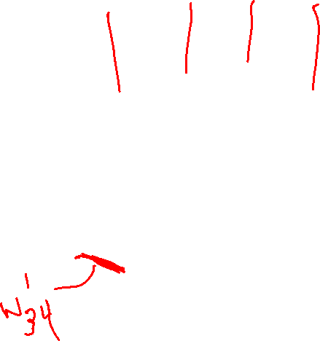
Neural Networks - Notation
$$l=layer (from 1 to L)$$
$$b^{l}=vector of bias inputs for l+1$$
$$b_{i}^{l}=bias value, layer l, node i$$
$$W^{l}=matrix of weights for l+1$$
$$w_{ji}^{l}=weigh value, layer l, nodes j to i$$
$$z^{l+1}=W^{l}a^{l}+b^{l}$$
$$a^{l+1}=g(z^{l+1})$$
ŷ = a^{L}

Slide 95
Neural Networks – Learning the Weights
Gradient Descent!
$w_{ij}^{l}$ = $w_{ij}^{l}−\text{η}\frac{∂C}{∂w_{ji}^{l}}$
$b_{i}^{l}$ = $b_{i}^{l}−\text{η}\frac{∂C}{∂b_{i}^{l}}$
This becomes intractable!

Slide 96
Back Propagation
$${\text{δ}}_{i}^{3}=\frac{∂C}{∂z_{i}^{3}}=\frac{∂C}{∂a_{i}^{3}}\frac{∂a_{i}^{3}}{∂z_{i}^{3}}, i=1,2$$
$${\text{δ}}_{i}^{3}=\frac{∂C}{∂z_{i}^{3}}=\frac{∂C}{∂a_{i}^{3}}g′(z_{i}^{3}), i=1,2$$
$${\text{δ}}^{3}={\text{▽}}_{a^{3}}\text{C} \text{⊙} g′(z_{i}^{3})$$

Slide 97

Back Propagation
Calculated ${\text{δ}}^{3}$ (delta vector for output layer)
$${\text{δ}}^{3}={\text{▽}}_{a^{3}}\text{C}\text{ ⊙} g′(z^{3})$$
But we need things in terms of weights and biases!
1
1
b¹
b²
Y₁
X₁
C(Y₁,Y₂)
Y₂
X₂
a¹
W¹
W²
z³|a³
z²|a²

Slide 98
The Multi-layer Perceptron
INPUT LAYER HIDDEN LAYER OUTPUT LAYER
$$W^{1}=\left[\begin{matrix}w_{11}^{1} & w_{12}^{1} \\ w_{21}^{1} & w_{22}^{1}\end{matrix}\right], b^{1}=\left[\begin{matrix}b_{1}^{1} \\ b_{2}^{1}\end{matrix}\right]$$
Intermediate Activities z
$$z^{2}=W^{1}x^{1}+b^{1}$$
Intermediate Activations a
$$a^{2}=g(z^{2})$$
1
1
$$b_{1}^{1}$$
$$b_{1}^{2}$$
a₁
Y₁
X₁
$$w_{11}^{1}$$
$$w_{11}^{2}$$
1 or -1
$$w_{21}^{1}$$
$$w_{21}^{2}$$
$$b_{2}^{1}$$
$$w_{12}^{1}$$
a₂
X₂
$$w_{22}^{1}$$

Slide 99
Computing delta in practice
$$\frac{∂C}{∂w_{21}^{2}}=$$

Slide 100
Computing delta in practice
$$\frac{∂C}{∂w_{21}^{2}}=\frac{∂C}{∂z_{2}^{3}}\frac{∂z_{2}^{3}}{∂w_{21}^{2}}={\text{δ}}_{2}^{3}\frac{∂z_{2}^{3}}{∂w_{21}^{2}}$$

Slide 101

Back Propagation
1
1
$$W^{1}=\left[\begin{matrix}w_{11}^{1} & w_{12}^{1} \\ w_{21}^{1} & w_{22}^{1}\end{matrix}\right], b^{1}=\left[\begin{matrix}b_{1}^{1} \\ b_{2}^{1}\end{matrix}\right]$$
Intermediate Activities z
$$z^{2}=W^{1}a^{1}+b^{1}$$
Intermediate Activations a
$$a^{2}=g(z^{2})$$
b¹
b²
Y₁
X₁
C(Y₁,Y₂)
Y₂
X₂
a¹
W¹
W²
z³|a³
z²|a²

Slide 102
Computing delta in practice
$$\frac{∂C}{∂w_{21}^{2}}=\frac{∂C}{∂z_{2}^{3}}\frac{∂z_{2}^{3}}{∂w_{21}^{2}}={\text{δ}}_{2}^{3}\frac{∂z_{2}^{3}}{∂w_{21}^{2}}$$
$$z^{3}=W^{2}a^{2}+ b^{2}$$
$$z_{2}^{3}=w_{21}^{2}a_{1}^{2}+w_{22}^{2}a_{2}^{2}+w_{23}^{2}a_{3}^{2}+b_{2}^{2}$$

Slide 103
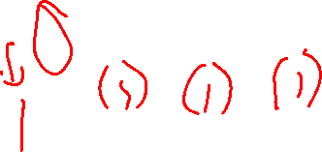
Computing delta in practice
$$\frac{∂C}{∂w_{21}^{2}}=\frac{∂C}{∂z_{2}^{3}}\frac{∂z_{2}^{3}}{∂w_{21}^{2}}={\text{δ}}_{2}^{3}\frac{∂z_{2}^{3}}{∂w_{21}^{2}}$$
$$z^{3}=W^{2}a^{2}+ b^{2}$$
$$z_{2}^{3}=w_{21}^{2}a_{1}^{2}+w_{22}^{2}a_{2}^{2}+w_{23}^{2}a_{3}^{2}+b_{2}^{2}$$

Slide 104
Computing delta in practice
$$\frac{∂C}{∂w_{21}^{2}}=\frac{∂C}{∂z_{2}^{3}}\frac{∂z_{2}^{3}}{∂w_{21}^{2}}={\text{δ}}_{2}^{3}\frac{∂z_{2}^{3}}{∂w_{21}^{2}}$$
$$z^{3}=W^{2}a^{2}+ b^{2}$$
$$z_{2}^{3}=w_{21}^{2}a_{1}^{2}+w_{22}^{2}a_{2}^{2}+w_{23}^{2}a_{3}^{2}+b_{2}^{2}$$
$$\frac{∂z_{2}^{3}}{∂w_{21}^{2}}=a_{1}^{2}$$

Slide 105

Computing delta in practice
$$\frac{∂C}{∂w_{21}^{2}}=\frac{∂C}{∂z_{2}^{3}}\frac{∂z_{2}^{3}}{∂w_{21}^{2}}={\text{δ}}_{2}^{3}a_{1}^{2}$$
$$\frac{∂C}{∂w_{ij}^{2}}=\frac{∂C}{∂z_{i}^{3}}\frac{∂z_{i}^{3}}{∂w_{ij}^{2}}={\text{δ}}_{i}^{3}a_{j}^{2}$$
For i =1, 2; j = 1, 2, 3

Slide 106
Back Propagation
$$\frac{∂C}{∂w_{ij}^{2}}=\frac{∂C}{∂z_{i}^{3}}\frac{∂z_{i}^{3}}{∂w_{ij}^{2}}={\text{δ}}_{i}^{3}a_{j}^{2}$$
For i = 1, 2; j = 1, 2, 3
1
1
b¹
b²
Y₁
X₁
C(Y₁,Y₂)
Y₂
X₂
a¹
W¹
W²
z³|a³
z²|a²

Slide 107
Back Propagation
$$\frac{∂C}{∂w_{ij}^{2}}=\frac{∂C}{∂z_{i}^{3}}\frac{∂z_{i}^{3}}{∂w_{ij}^{2}}={\text{δ}}_{i}^{3}a_{j}^{2}$$
For i = 1, 2; j = 1, 2, 3
$$W^{2}=\left[\begin{matrix}w_{11}^{2} & w_{12}^{2} & w_{13}^{2} \\ w_{21}^{2} & w_{22}^{2} & w_{23}^{2}\end{matrix}\right]$$
1
1
b¹
b²
Y₁
X₁
C(Y₁,Y₂)
Y₂
X₂
a¹
W¹
W²
z³|a³
z²|a²

Slide 108
Back Propagation
$$\frac{∂C}{∂w_{ij}^{2}}=\frac{∂C}{∂z_{i}^{3}}\frac{∂z_{i}^{3}}{∂w_{ij}^{2}}={\text{δ}}_{i}^{3}a_{j}^{2}$$
For i = 1, 2; j = 1, 2, 3
$$W^{2}=\left[\begin{matrix}w_{11}^{2} & w_{12}^{2} & w_{13}^{2} \\ w_{21}^{2} & w_{22}^{2} & w_{23}^{2}\end{matrix}\right]$$
$$\frac{∂C}{∂w^{2}}=\left[\begin{matrix}\frac{∂C}{∂w_{11}^{2}} & \frac{∂C}{∂w_{12}^{2}} & \frac{∂C}{∂w_{13}^{2}} \\ \frac{∂C}{∂w_{21}^{2}} & \frac{∂C}{∂w_{22}^{2}} & \frac{∂C}{∂w_{23}^{2}}\end{matrix}\right]$$
1
1
b¹
b²
Y₁
X₁
C(Y₁,Y₂)
Y₂
X₂
a¹
W¹
W²
z³|a³
z²|a²

Slide 109
Back Propagation
$$\frac{∂C}{∂w_{ij}^{2}}=\frac{∂C}{∂z_{i}^{3}}\frac{∂z_{i}^{3}}{∂w_{ij}^{2}}={\text{δ}}_{i}^{3}a_{j}^{2}$$
For i = 1, 2; j = 1, 2, 3
$$W^{2}=\left[\begin{matrix}w_{11}^{2} & w_{12}^{2} & w_{13}^{2} \\ w_{21}^{2} & w_{22}^{2} & w_{23}^{2}\end{matrix}\right]$$
$$\frac{∂C}{∂w^{2}}=\left[\begin{matrix}\frac{∂C}{∂w_{11}^{2}} & \frac{∂C}{∂w_{12}^{2}} & \frac{∂C}{∂w_{13}^{2}} \\ \frac{∂C}{∂w_{21}^{2}} & \frac{∂C}{∂w_{22}^{2}} & \frac{∂C}{∂w_{23}^{2}}\end{matrix}\right]$$
$$\frac{∂C}{∂w^{2}}=\left[\begin{matrix}{\text{δ}}_{1}^{3}a_{1}^{2} & {\text{δ}}_{1}^{3}a_{2}^{2} & {\text{δ}}_{1}^{3}a_{3}^{2} \\ {\text{δ}}_{2}^{3}a_{1}^{2} & {\text{δ}}_{2}^{3}a_{2}^{2} & {\text{δ}}_{2}^{3}a_{3}^{2}\end{matrix}\right]$$
1
1
b¹
b²
Y₁
X₁
C(Y₁,Y₂)
Y₂
X₂
a¹
W¹
W²
z³|a³
z²|a²

Slide 110
Back Propagation
$$\frac{∂C}{∂w_{ij}^{2}}=\frac{∂C}{∂z_{i}^{3}}\frac{∂z_{i}^{3}}{∂w_{ij}^{2}}={\text{δ}}_{i}^{3}a_{j}^{2}$$
For i = 1, 2; j = 1, 2, 3
$$W^{2}=\left[\begin{matrix}w_{11}^{2} & w_{12}^{2} & w_{13}^{2} \\ w_{21}^{2} & w_{22}^{2} & w_{23}^{2}\end{matrix}\right]$$
$$\frac{∂C}{∂w^{2}}=\left[\begin{matrix}\frac{∂C}{∂w_{11}^{2}} & \frac{∂C}{∂w_{12}^{2}} & \frac{∂C}{∂w_{13}^{2}} \\ \frac{∂C}{∂w_{21}^{2}} & \frac{∂C}{∂w_{22}^{2}} & \frac{∂C}{∂w_{23}^{2}}\end{matrix}\right]$$
$$\frac{∂C}{∂w^{2}}=\left[\begin{matrix}{\text{δ}}_{1}^{3}a_{1}^{2} & {\text{δ}}_{1}^{3}a_{2}^{2} & {\text{δ}}_{1}^{3}a_{3}^{2} \\ {\text{δ}}_{2}^{3}a_{1}^{2} & {\text{δ}}_{2}^{3}a_{2}^{2} & {\text{δ}}_{2}^{3}a_{3}^{2}\end{matrix}\right]$$
$$\frac{∂C}{∂w^{2}}={\text{δ}}^{3}{{(a}^{2})}^{T}$$
1
1
b¹
b²
Y₁
X₁
C(Y₁,Y₂)
Y₂
X₂
a¹
W¹
W²
z³|a³
z²|a²

Slide 111
Back Propagation
$$\frac{∂C}{∂w^{2}}={\text{δ}}^{3}{{(a}^{2})}^{T}$$
The derivatives of C for each weight are found in our matrix!
But we also have derivatives of C for each bias term…
1
1
b¹
b²
Y₁
X₁
C(Y₁,Y₂)
Y₂
X₂
a¹
W¹
W²
z³|a³
z²|a²

Slide 112

Computing delta in practice
$$\frac{∂C}{∂b_{1}^{2}}=\frac{∂C}{∂z_{1}^{3}}\frac{∂z_{1}^{3}}{∂b_{1}^{2}}={\text{δ}}_{2}^{3}\frac{∂z_{1}^{3}}{∂b_{1}^{2}}$$
$$z^{3}=W^{2}a^{2}+ b^{2}$$
$$z_{1}^{3}=w_{11}^{2}a_{1}^{2}+w_{12}^{2}a_{2}^{2}+w_{13}^{2}a_{3}^{2}+b_{1}^{2}$$

Slide 113
Computing delta in practice
$$\frac{∂C}{∂b_{1}^{2}}=\frac{∂C}{∂z_{1}^{3}}\frac{∂z_{1}^{3}}{∂b_{1}^{2}}={\text{δ}}_{2}^{3}\frac{∂z_{1}^{3}}{∂b_{1}^{2}}$$
$$z^{3}=W^{2}a^{2}+ b^{2}$$
$$z_{1}^{3}=w_{11}^{2}a_{1}^{2}+w_{12}^{2}a_{2}^{2}+w_{13}^{2}a_{3}^{2}+b_{1}^{2}$$
$$\frac{∂z_{1}^{3}}{∂b_{1}^{2}}=1$$

Slide 114
Computing delta in practice
$$\frac{∂C}{∂b_{1}^{2}}=\frac{∂C}{∂z_{1}^{3}}\frac{∂z_{1}^{3}}{∂b_{1}^{2}}={\text{δ}}_{2}^{3}\frac{∂z_{1}^{3}}{∂b_{1}^{2}}$$
$$z^{3}=W^{2}a^{2}+ b^{2}$$
$$z_{1}^{3}=w_{11}^{2}a_{1}^{2}+w_{12}^{2}a_{2}^{2}+w_{13}^{2}a_{3}^{2}+b_{1}^{2}$$
$$\frac{∂z_{1}^{3}}{∂b_{1}^{2}}=1$$
$$\frac{∂C}{∂b_{1}^{2}}=\frac{∂C}{∂z_{1}^{3}}\frac{∂z_{1}^{3}}{∂b_{1}^{2}}={\text{δ}}_{1}^{3}∗1$$

Slide 115
Computing delta in practice
$$\frac{∂C}{∂b_{1}^{2}}=\frac{∂C}{∂z_{1}^{3}}\frac{∂z_{1}^{3}}{∂b_{1}^{2}}={\text{δ}}_{1}^{3}∗1$$
$$\frac{∂C}{∂b_{i}^{2}}=\frac{∂C}{∂z_{i}^{3}}\frac{∂z_{i}^{3}}{∂b_{i}^{2}}={\text{δ}}_{i}^{3}$$
$$\frac{∂C}{∂b^{2}}={\text{δ}}^{3}$$

Slide 116
Back Propagation So Far…
For a training example x_{k}
propagate forward to get activity vector z_{l} and activation vector a_{l} for each layer
To get the derivatives our final layer, we calculate
${\text{δ}}^{3}={\text{▽}}_{a^{3}}\text{C}\text{ ⊙} g′(z_{i}^{3})$
$\frac{∂C}{∂w^{2}}={\text{δ}}^{3}{{(a}^{2})}^{T}$
$\frac{∂C}{∂b^{2}}={\text{δ}}^{3}$

Slide 117

Back Propagation
$${\text{δ}}^{3}={\text{▽}}_{a^{3}}\text{C}\text{ ⊙} g′(z_{i}^{3})$$
$$\frac{∂C}{∂w^{2}}={\text{δ}}^{3}{{(a}^{2})}^{T}$$
$$\frac{∂C}{∂b^{2}}={\text{δ}}^{3}$$
We’ve got the derivatives for our last layer (layer 3).
But what do we need for the previous layer (layer 2)?
1
1
b¹
b²
Y₁
X₁
C(Y₁,Y₂)
Y₂
X₂
a¹
W¹
W²
z³|a³
z²|a²

Slide 118
Back Propagation
$${\text{δ}}^{3}={\text{▽}}_{a^{3}}\text{C}\text{ ⊙} g′(z_{i}^{3})$$
$$\frac{∂C}{∂w^{2}}={\text{δ}}^{3}{{(a}^{2})}^{T}$$
$$\frac{∂C}{∂b^{2}}={\text{δ}}^{3}$$
We’ve got the derivatives for our last layer (layer 3).
But what do we need for the previous layer (layer 2)?
${\text{δ}}^{2}$ would be nice…
1
1
b¹
b²
Y₁
X₁
C(Y₁,Y₂)
Y₂
X₂
a¹
W¹
W²
z³|a³
z²|a²

Slide 119
Back Propagation
$${\text{δ}}^{3}={\text{▽}}_{a^{3}}\text{C}\text{ ⊙} g′(z_{i}^{3})$$
$$\frac{∂C}{∂w^{2}}={\text{δ}}^{3}{{(a}^{2})}^{T}$$
$$\frac{∂C}{∂b^{2}}={\text{δ}}^{3}$$
We’ve got the derivatives for our last layer (layer 3).
But what do we need for the previous layer (layer 2)?
${\text{δ}}^{2}$ would be nice…
But the relationship between C and z² is complicated by our activation functions…
1
1
b¹
b²
Y₁
X₁
C(Y₁,Y₂)
Y₂
X₂
a¹
W¹
W²
z³|a³
z²|a²

Slide 120
Computing inner-layer $\text{δ}$
$${\text{δ}}^{2} depends on {\text{δ}}^{3}$$
To create a specific example…
And we define ${\text{δ}}_{2}^{2}$ as
$${\text{δ}}_{2}^{2}=\frac{∂C}{∂z_{2}^{2}}$$
And we can see that
$${\text{δ}}_{2}^{2} depends on {\text{δ}}_{1}^{3}an\text{d} {\text{δ}}_{2}^{3}$$
So we can apply the chain rule!
1
1
b¹
b²
Y₁
X₁
C(Y₁,Y₂)
Y₂
X₂
a¹
W¹
W²
z³|a³
z²|a²

Slide 121
Computing inner-layer $\text{δ}$
$${\text{δ}}_{2}^{2}=\frac{∂C}{∂z_{2}^{2}}=\frac{∂C}{∂z_{1}^{3}}\frac{∂z_{1}^{3}}{∂z_{2}^{2}}+\frac{∂C}{∂z_{2}^{3}}\frac{∂z_{2}^{3}}{∂z_{2}^{2}}$$
1
1
b¹
b²
Y₁
X₁
C(Y₁,Y₂)
Y₂
X₂
a¹
W¹
W²
z³|a³
z²|a²

Slide 122
Computing inner-layer $\text{δ}$
$${\text{δ}}_{2}^{2}=\frac{∂C}{∂z_{2}^{2}}=\frac{∂C}{∂z_{1}^{3}}\frac{∂z_{1}^{3}}{∂z_{2}^{2}}+\frac{∂C}{∂z_{2}^{3}}\frac{∂z_{2}^{3}}{∂z_{2}^{2}}$$
Becomes
$${\text{δ}}_{1}^{3}\frac{∂z_{1}^{3}}{∂z_{2}^{2}}+{\text{δ}}_{2}^{3}\frac{∂z_{2}^{3}}{∂z_{2}^{2}}$$
We’re computing the derivatives of level 3 activities in terms of level 2 activities
1
1
b¹
b²
Y₁
X₁
C(Y₁,Y₂)
Y₂
X₂
a¹
W¹
W²
z³|a³
z²|a²

Slide 123

Computing inner-layer $\text{δ}$
$${\text{δ}}_{2}^{2}=\frac{∂C}{∂z_{2}^{2}}={\text{δ}}_{1}^{3}\frac{∂z_{1}^{3}}{∂z_{2}^{2}}+{\text{δ}}_{2}^{3}\frac{∂z_{2}^{3}}{∂z_{2}^{2}}$$
We’re computing the derivatives of level 3 activities (z³) in terms of level 2 activities (z²)
$$z^{3}=W^{2}a^{2}+ b^{2}$$
$$z_{i}^{3}=w_{i1}^{2}a_{1}^{2}+w_{i2}^{2}a_{2}^{2}+w_{i3}^{2}a_{3}^{2}+b_{i}^{2}$$
Activations (a) are just activities (z) run through our activation function (g())
$$z_{i}^{3}=w_{i1}^{2}g(z_{1}^{2})+w_{i2}^{2}g(z_{2}^{2})+w_{i3}^{2}g(z_{3}^{2})+b_{i}^{2}$$
1
1
b¹
b²
Y₁
X₁
C(Y₁,Y₂)
Y₂
X₂
a¹
W¹
W²
z³|a³
z²|a²

Slide 124

Computing inner-layer $\text{δ}$
$${\text{δ}}_{2}^{2}=\frac{∂C}{∂z_{2}^{2}}={\text{δ}}_{1}^{3}\frac{∂z_{1}^{3}}{∂z_{2}^{2}}+{\text{δ}}_{2}^{3}\frac{∂z_{2}^{3}}{∂z_{2}^{2}}$$
And
$$z^{3}=W^{2}a^{2}+ b^{2}$$
$$z_{i}^{3}=w_{i1}^{2}a_{1}^{2}+w_{i2}^{2}a_{2}^{2}+w_{i3}^{2}a_{3}^{2}+b_{i}^{2}$$
$$z_{i}^{3}=w_{i1}^{2}g(z_{1}^{2})+w_{i2}^{2}g(z_{2}^{2})+w_{i3}^{2}g(z_{3}^{2})+b_{i}^{2}$$
And
$$\frac{∂z_{i}^{3}}{∂z_{2}^{2}}= w_{i2}^{2}g′(z_{2}^{2})$$
Plugging it all in…
1
1
b¹
b²
Y₁
X₁
C(Y₁,Y₂)
Y₂
X₂
a¹
W¹
W²
z³|a³
z²|a²

Slide 125

Computing inner-layer $\text{δ}$
$${\text{δ}}_{2}^{2}=\frac{∂C}{∂z_{2}^{2}}={\text{δ}}_{1}^{3}\frac{∂z_{1}^{3}}{∂z_{2}^{2}}+{\text{δ}}_{2}^{3}\frac{∂z_{2}^{3}}{∂z_{2}^{2}}$$
and
$$z^{3}=W^{2}a^{2}+ b^{2}$$
$$z_{i}^{3}=w_{i1}^{2}a_{1}^{2}+w_{i2}^{2}a_{2}^{2}+w_{i3}^{2}a_{3}^{2}+b_{i}^{2}$$
$$z_{i}^{3}=w_{i1}^{2}g(z_{1}^{2})+w_{i2}^{2}g(z_{2}^{2})+w_{i3}^{2}g(z_{3}^{2})+b_{i}^{2}$$
And
$$\frac{∂z_{i}^{3}}{∂z_{2}^{2}}= w_{i2}^{2}g′(z_{2}^{2})$$
Plugging it all in…
$${\text{δ}}_{2}^{2}=\frac{∂C}{∂z_{2}^{2}}={\text{δ}}_{1}^{3}w_{12}^{2}g′(z_{2}^{2})+{\text{δ}}_{2}^{3}w_{22}^{2}g′(z_{2}^{2})$$
(You can do the same process for ${\text{δ}}_{1}^{2}$ and ${\text{δ}}_{3}^{2}$)
1
1
b¹
b²
Y₁
X₁
C(Y₁,Y₂)
Y₂
X₂
a¹
W¹
W²
z³|a³
z²|a²

Slide 126
Back Propagation
$${\text{δ}}_{1}^{2}=\frac{∂C}{∂z_{1}^{2}}={\text{δ}}_{1}^{3}w_{11}^{2}g^{′}\left(z_{1}^{2}\right)+{\text{δ}}_{2}^{3}w_{21}^{2}g^{′}\left(z_{1}^{2}\right)$$
$${\text{δ}}_{2}^{2}=\frac{∂C}{∂z_{2}^{2}}={\text{δ}}_{1}^{3}w_{12}^{2}g′(z_{2}^{2})+{\text{δ}}_{2}^{3}w_{22}^{2}g′(z_{2}^{2})$$
$${\text{δ}}_{3}^{2}=\frac{∂C}{∂z_{3}^{2}}={\text{δ}}_{1}^{3}w_{13}^{2}g′(z_{3}^{2})+{\text{δ}}_{2}^{3}w_{23}^{2}g′(z_{3}^{2})$$

Slide 127
Back Propagation
$${\text{δ}}_{1}^{2}=\frac{∂C}{∂z_{1}^{2}}=({\text{δ}}_{1}^{3}w_{11}^{2}+{\text{δ}}_{2}^{3}w_{21}^{2})∙g^{′}\left(z_{1}^{2}\right)$$
$${\text{δ}}_{2}^{2}=\frac{∂C}{∂z_{2}^{2}}=({\text{δ}}_{1}^{3}w_{12}^{2}+{\text{δ}}_{2}^{3}w_{22}^{2})∙g′(z_{2}^{2})$$
$${\text{δ}}_{3}^{2}=\frac{∂C}{∂z_{3}^{2}}=({\text{δ}}_{1}^{3}w_{13}^{2}+{\text{δ}}_{2}^{3}w_{23}^{2})∙g′(z_{3}^{2})$$
Factor out derivative of g…

Slide 128
Back Propagation
$${\text{δ}}_{1}^{2}=\frac{∂C}{∂z_{1}^{2}}=({\text{δ}}_{1}^{3}w_{11}^{2}+{\text{δ}}_{2}^{3}w_{21}^{2})∙g^{′}\left(z_{1}^{2}\right)$$
$${\text{δ}}_{2}^{2}=\frac{∂C}{∂z_{2}^{2}}=({\text{δ}}_{1}^{3}w_{12}^{2}+{\text{δ}}_{2}^{3}w_{22}^{2})∙g′(z_{2}^{2})$$
$${\text{δ}}_{3}^{2}=\frac{∂C}{∂z_{3}^{2}}=\left({\text{δ}}_{1}^{3}w_{13}^{2}+{\text{δ}}_{2}^{3}w_{23}^{2}\right)∙g^{′}\left(z_{3}^{2}\right)$$
And remember…
${\text{δ}}^{3}= \left[\begin{matrix}{\text{δ}}_{1}^{3} \\ {\text{δ}}_{2}^{3}\end{matrix}\right]$ and $W^{2}=\left[\begin{matrix}w_{11}^{2} & w_{12}^{2} & w_{13}^{2} \\ w_{21}^{2} & w_{22}^{2} & w_{23}^{2}\end{matrix}\right]$

Slide 129
Back Propagation
$${\text{δ}}_{1}^{2}=\frac{∂C}{∂z_{1}^{2}}=({\text{δ}}_{1}^{3}w_{11}^{2}+{\text{δ}}_{2}^{3}w_{21}^{2})∙g^{′}\left(z_{1}^{2}\right)$$
$${\text{δ}}_{2}^{2}=\frac{∂C}{∂z_{2}^{2}}=({\text{δ}}_{1}^{3}w_{12}^{2}+{\text{δ}}_{2}^{3}w_{22}^{2})∙g′(z_{2}^{2})$$
$${\text{δ}}_{3}^{2}=\frac{∂C}{∂z_{3}^{2}}=\left({\text{δ}}_{1}^{3}w_{13}^{2}+{\text{δ}}_{2}^{3}w_{23}^{2}\right)∙g^{′}\left(z_{3}^{2}\right)$$
And remember…
${\text{δ}}^{3}= \left[\begin{matrix}{\text{δ}}_{1}^{3} \\ {\text{δ}}_{2}^{3}\end{matrix}\right]$ and ${(W^{2})}^{T}=\left[\begin{matrix}w_{11}^{2} & w_{21}^{2} \\ w_{12}^{2} & w_{22}^{2} \\ w_{13}^{2} & w_{23}^{2}\end{matrix}\right]$

Slide 130
Back Propagation
$${\text{δ}}_{1}^{2}=\frac{∂C}{∂z_{1}^{2}}=({\text{δ}}_{1}^{3}w_{11}^{2}+{\text{δ}}_{2}^{3}w_{21}^{2})∙g^{′}\left(z_{1}^{2}\right)$$
$${\text{δ}}_{2}^{2}=\frac{∂C}{∂z_{2}^{2}}=({\text{δ}}_{1}^{3}w_{12}^{2}+{\text{δ}}_{2}^{3}w_{22}^{2})∙g′(z_{2}^{2})$$
$${\text{δ}}_{3}^{2}=\frac{∂C}{∂z_{3}^{2}}=\left({\text{δ}}_{1}^{3}w_{13}^{2}+{\text{δ}}_{2}^{3}w_{23}^{2}\right)∙g^{′}\left(z_{3}^{2}\right)$$
$${\text{δ}}^{2}=\left[\begin{matrix}{\text{δ}}_{1}^{2} \\ {\text{δ}}_{2}^{2} \\ {\text{δ}}_{3}^{2}\end{matrix}\right]= \left[\begin{matrix}w_{11}^{2} & w_{21}^{2} \\ w_{12}^{2} & w_{22}^{2} \\ w_{13}^{2} & w_{23}^{2}\end{matrix}\right]\left[\begin{matrix}{\text{δ}}_{1}^{3} \\ {\text{δ}}_{2}^{3}\end{matrix}\right]\text{⊙}\left[\begin{matrix}g^{′}\left(z_{1}^{2}\right) \\ g^{′}\left(z_{2}^{2}\right) \\ g^{′}\left(z_{3}^{2}\right)\end{matrix}\right]={(W^{2})}^{T}{\text{δ}}^{3}\text{⊙}g^{′}\left(z^{2}\right)$$

Slide 131
Back Propagation
Now we have our $\text{δ}$
$${\text{δ}}^{2}={(W^{2})}^{T}{\text{δ}}^{3}\text{⊙}g^{′}\left(z^{2}\right)$$
Compute our Weight and Bias derivatives as before!

Slide 132
Back Propagation
$$\text{Now} \text{we} \text{have} \text{our} \text{δ}$$
$${\text{δ}}^{2}={(W^{2})}^{T}{\text{δ}}^{3}\text{⊙}g^{′}\left(z^{2}\right)$$
$$\text{Compute} \text{our} \text{Weight} \text{and} \text{Bias} \text{derivatives} \text{as} \text{before}\text{!}$$
$$\frac{∂C}{∂w^{1}}={\text{δ}}^{2}{{(a}^{1})}^{T}$$
$$\frac{∂C}{∂b^{1}}={\text{δ}}^{2}$$

Slide 133
Back Propagation – General Algorithm
Compute $\text{δ}$ for the output layer L
$${\text{δ}}^{L}={\text{▽}}_{a^{L}}\text{C}\text{ ⊙} g′(z^{L})$$
$for l=L$-1, ... 2
Compute the Weight Derivatives
$$\frac{∂C}{∂w^{l}}={\text{δ}}^{l+1}{{(a}^{l})}^{T}$$
compute the Bias Derivatives
$$\frac{∂C}{∂b^{l}}={\text{δ}}^{l+1}$$
back-propagate to previous layer
$${\text{δ}}^{l}={(W^{l})}^{T}{\text{δ}}^{l+1}\text{⊙}g^{′}\left(z^{l}\right)$$

Slide 134
Updating – SGD using Back Propagation
$$W^{l }←W^{l} −\text{η}\frac{∂C}{∂w^{l}},b^{l }←b^{l} −\text{η}\frac{∂C}{∂b^{l}}$$

Slide 135
Where We Are
1
1
b¹
b²
Feed-Forward Neural Network
Initialize Weights
Y₁
X₁
Y₂
X₂
W¹
W²

Slide 136
Where We Are
1
1
b¹
b²
Feed-Forward Neural Network
Initialize Weights
SGD loop (for random example):
forward propagate for activations
Y₁
X₁
C(Y₁,Y₂)
Y₂
X₂
a¹
W¹
W²
z³|a³
z²|a²

Slide 137
Where We Are
1
1
$$\frac{∂C}{∂b^{l}}$$
$$\frac{∂C}{∂b^{l}}$$
Feed-Forward Neural Network
Initialize Weights
SGD loop (for random example):
forward propagate for activations
backward propagate for derivatives
Y₁
X₁
C(Y₁,Y₂)
Y₂
X₂
a¹
$$\frac{∂C}{∂w^{1}}$$
$$\frac{∂C}{∂w^{2}}$$
z³|a³
z²|a²

Slide 138
Where We Are
1
1
b¹
b²
Feed-Forward Neural Network
Initialize Weights
SGD loop (for random example):
forward propagate for activations
backward propagate for derivatives
update weights
Y₁
X₁
Y₂
X₂
W¹
W²

Slide 139
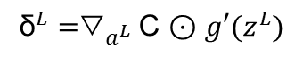
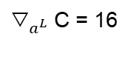
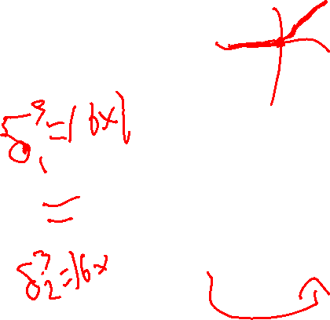
Where We Are
1
1
Back Propagation
ReLU Activation
a = max(0,z)
b¹
b²
-1
-1
-1
-1
Z=0
a=0
1
1
Y₁
z=4
a=4
X₁
-1
-2
-1
2
-3
z=1
a=1
1
${\text{▽}}_{a^{L}}\text{C}$= 16
$${\text{δ}}^{L}={\text{▽}}_{a^{L}}\text{C}\text{ ⊙} g′(z^{L})$$
1
-1
2
Y₂
z=-4
a=0
X₂
1
3
z=2
a=2
-1
3
W¹
W²

Slide 140
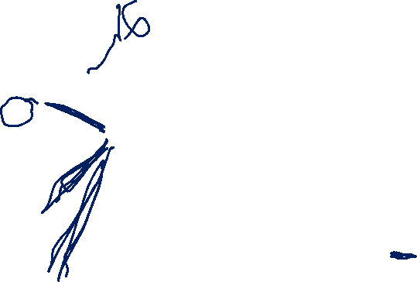
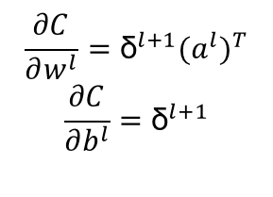
Where We Are
1
1
Back Propagation
ReLU Activation
a = max(0,z)
b¹
b²
-1
-1
$${\begin{aligned}\text{δ}\text{=16 ∗ 1} \\ \text{δ}=16\end{aligned}}^{}$$
-1
-1
Z=0
a=0
1
1
Y₁
z=4
a=4
X₁
-1
-2
-1
2
-3
z=1
a=1
1
${\text{▽}}_{a^{L}}\text{C}$= 16
$$\frac{∂C}{∂w^{l}}={\text{δ}}^{l+1}{{(a}^{l})}^{T}$$
$$\frac{∂C}{∂b^{l}}={\text{δ}}^{l+1}$$
$${\begin{aligned}\text{δ}\text{=16 ∗ 0 } \\ \text{δ}=0\end{aligned}}^{}$$
1
-1
2
Y₂
z=-4
a=0
X₂
1
3
z=2
a=2
-1
3
W¹
W²

Slide 141
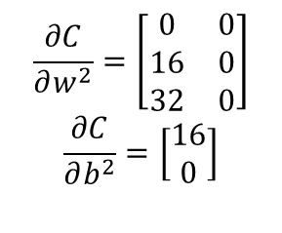
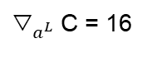
Where We Are
1
1
Back Propagation
ReLU Activation
a = max(0,z)
b¹
b²
-1
-1
$${\begin{aligned}\text{δ}\text{=16 ∗ 1} \\ \text{δ}=16\end{aligned}}^{}$$
-1
-1
Z=0
a=0
1
1
Y₁
z=4
a=4
X₁
-1
-2
-1
2
-3
z=1
a=1
1
${\text{▽}}_{a^{L}}\text{C}$= 16
$$\frac{∂C}{∂w^{2}}=\left[\begin{matrix}\begin{matrix}0 \\ 16 \\ 32\end{matrix} & \begin{matrix}0 \\ 0 \\ 0\end{matrix}\end{matrix}\right]$$
$$\frac{∂C}{∂b^{2}}=\left[\begin{matrix}16 \\ 0\end{matrix}\right]$$
$${\begin{aligned}\text{δ}\text{=16 ∗ 0 } \\ \text{δ}=0\end{aligned}}^{}$$
1
-1
2
Y₂
z=-4
a=0
X₂
1
3
z=2
a=2
-1
3
W¹
W²

Slide 142
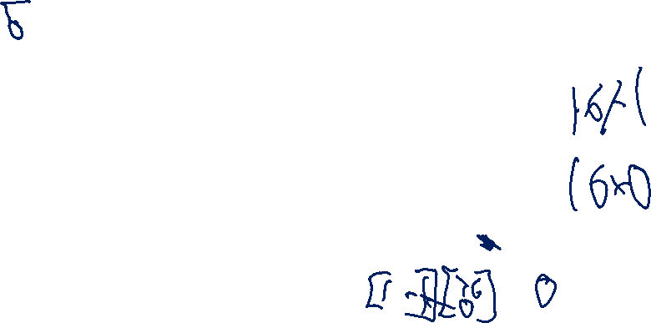
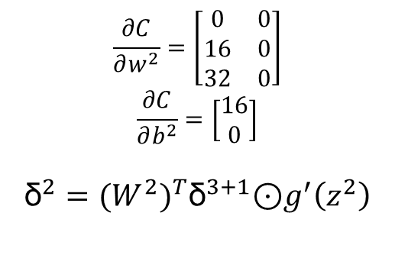
Where We Are
1
1
Back Propagation
ReLU Activation
a = max(0,z)
b¹
b²
-1
-1
$${\begin{aligned}\text{δ}\text{=16 ∗ 1} \\ \text{δ}=16\end{aligned}}^{}$$
-1
-1
Z=0
a=0
1
1
Y₁
z=4
a=4
X₁
-1
-2
-1
$$\frac{∂C}{∂w^{2}}=\left[\begin{matrix}\begin{matrix}0 \\ 16 \\ 32\end{matrix} & \begin{matrix}0 \\ 0 \\ 0\end{matrix}\end{matrix}\right]$$
$$\frac{∂C}{∂b^{2}}=\left[\begin{matrix}16 \\ 0\end{matrix}\right]$$
$${\text{δ}}^{2}={(W^{2})}^{T}{\text{δ}}^{3+1}\text{⊙}g^{′}\left(z^{2}\right)$$
2
-3
z=1
a=1
1
${\text{▽}}_{a^{L}}\text{C}$= 16
$${\begin{aligned}\text{δ}\text{=16 ∗ 0 } \\ \text{δ}=0\end{aligned}}^{}$$
1
-1
2
Y₂
z=-4
a=0
X₂
1
3
z=2
a=2
-1
3
W¹
W²

Slide 143
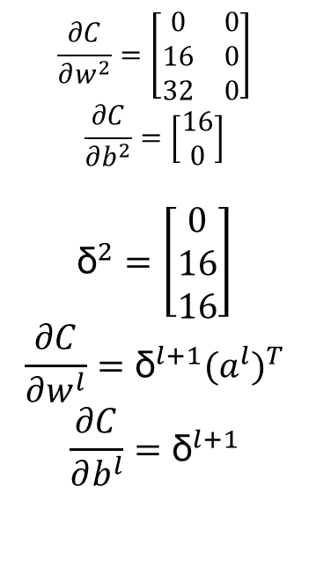
Where We Are
Back Propagation
ReLU Activation
a = max(0,z)
1
1
b¹
b²
-1
-1
$${\begin{aligned}\text{δ}\text{=16 ∗ 1} \\ \text{δ}=16\end{aligned}}^{}$$
$$\frac{∂C}{∂w^{2}}=\left[\begin{matrix}\begin{matrix}0 \\ 16 \\ 32\end{matrix} & \begin{matrix}0 \\ 0 \\ 0\end{matrix}\end{matrix}\right]$$
$$\frac{∂C}{∂b^{2}}=\left[\begin{matrix}16 \\ 0\end{matrix}\right]$$
$${\text{δ}}^{2}=\left[\begin{matrix}0 \\ 16 \\ 16\end{matrix}\right]$$
$$\frac{∂C}{∂w^{l}}={\text{δ}}^{l+1}{{(a}^{l})}^{T}$$
$$\frac{∂C}{∂b^{l}}={\text{δ}}^{l+1}$$
-1
-1
Z=0
a=0
1
1
Y₁
z=4
a=4
X₁
-1
-2
-1
2
-3
z=1
a=1
1
${\text{▽}}_{a^{L}}\text{C}$= 16
$${\begin{aligned}\text{δ}\text{=16 ∗ 0 } \\ \text{δ}=0\end{aligned}}^{}$$
1
-1
2
Y₂
z=-4
a=0
X₂
1
3
z=2
a=2
-1
3
W¹
W²

Slide 144

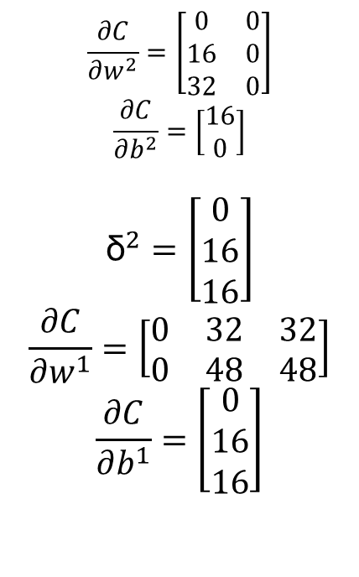
Where We Are
Back Propagation
ReLU Activation
a = max(0,z)
1
1
b¹
b²
$$\frac{∂C}{∂w^{2}}=\left[\begin{matrix}\begin{matrix}0 \\ 16 \\ 32\end{matrix} & \begin{matrix}0 \\ 0 \\ 0\end{matrix}\end{matrix}\right]$$
$$\frac{∂C}{∂b^{2}}=\left[\begin{matrix}16 \\ 0\end{matrix}\right]$$
$${\text{δ}}^{2}=\left[\begin{matrix}0 \\ 16 \\ 16\end{matrix}\right]$$
$$\frac{∂C}{∂w^{1}}=\left[\begin{matrix}0 & 32 & 32 \\ 0 & 48 & 48\end{matrix}\right]$$
$$\frac{∂C}{∂b^{1}}=\left[\begin{matrix}0 \\ 16 \\ 16\end{matrix}\right]$$
-1
-1
$${\begin{aligned}\text{δ}\text{=16 ∗ 1} \\ \text{δ}=16\end{aligned}}^{}$$
-1
-1
Z=0
a=0
1
1
Y₁
z=4
a=4
X₁
-1
-2
-1
2
-3
z=1
a=1
1
${\text{▽}}_{a^{L}}\text{C}$= 16
$${\begin{aligned}\text{δ}\text{=16 ∗ 0 } \\ \text{δ}=0\end{aligned}}^{}$$
1
-1
2
Y₂
z=-4
a=0
X₂
1
3
z=2
a=2
-1
3
W¹
W²

Slide 145
Friday

Slide 146
Course Logistics
Problem Set 4 – Due Friday, March 24
That’s right before Spring Break!
PS5 will be available over Spring Break, but Spring Break is not part of the expected weeks of completion time
Participation 8 - SVMs
Project Milestone 3 – On Canvas!
Exam 1 – March 13
Review on Friday March 10 – Today!

Slide 147
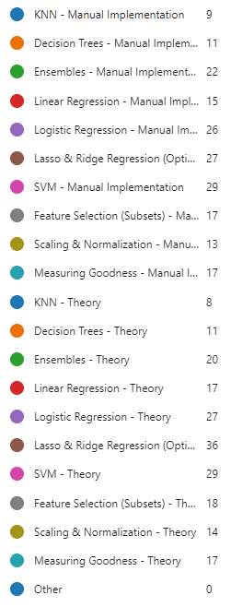
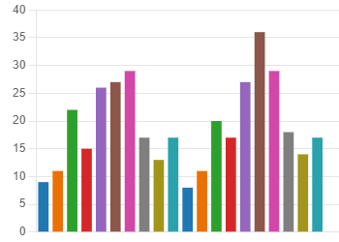

Exam 1 Topics Poll

Slide 148
Lasso & Ridge Regression

Slide 149
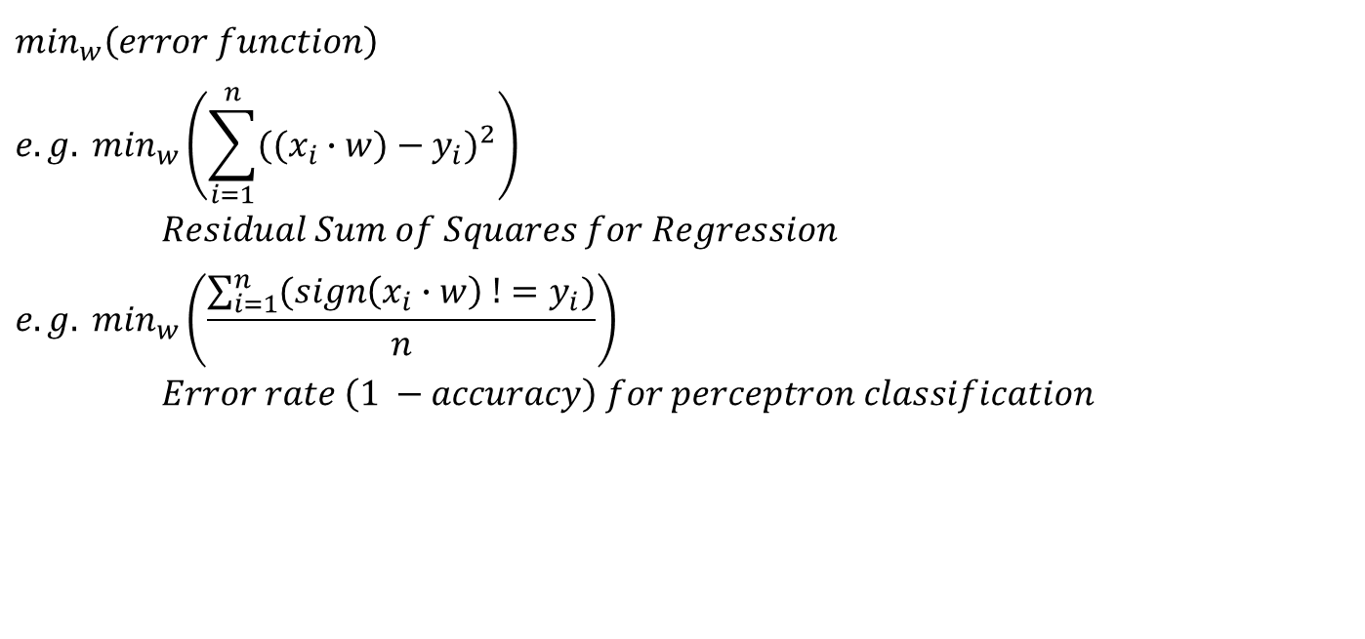
Optimizing Weights
$$\min_{w}\left(error function\right)$$
$$e.g. \min_{w}\left(\sum_{i=1}^{n}{{((x_{i}∙w)−y_{i})}^{2}}\right)$$
$Residual Sum of Squares for Regression$
$$e.g. \min_{w}\left(\frac{\sum_{i=1}^{n}{(sign\left(x_{i}∙w\right) !=y_{i})}}{n}\right)$$
$Error rate \left(1 −accuracy\right) for perceptron classification$

Slide 150
Optimizing Weights
We don’t want a weight to spiral out of control due to some oddity in our training data…
See Participation 5 for some hands-on evidence of issues related to this topic!

Slide 151
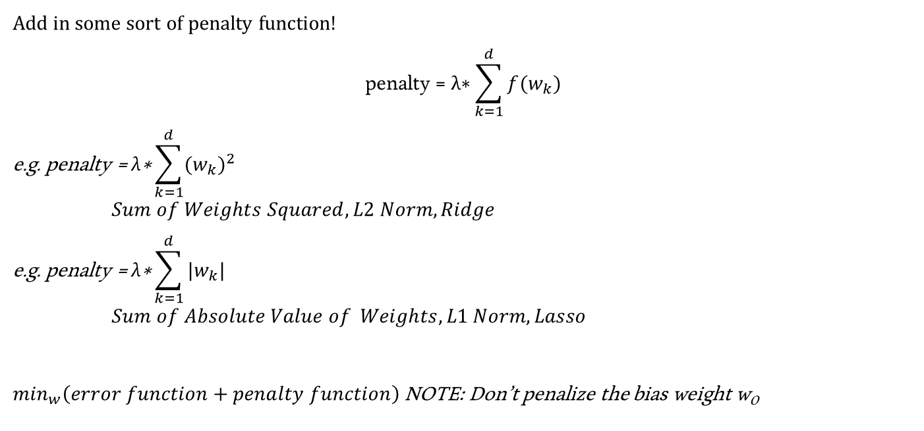
Optimizing Weights – Penalty Term
Add in some sort of penalty function!
$$\text{penalty}\text{ = }\text{λ}\text{∗}\sum_{k=1}^{d}{f(w_{k})}$$
$$\text{e}\text{.}\text{g}\text{. }\text{penalty}\text{ = }\text{λ}\text{∗}\sum_{k=1}^{d}{{(w_{k})}^{2}}$$
$Sum of Weights Squared, L2 Norm, Ridge$
$$\text{e}\text{.}\text{g}\text{. }\text{penalty}\text{ = }\text{λ}\text{∗}\sum_{k=1}^{d}{|w_{k}|}$$
$Sum of Absolute Value of Weights, L1 Norm, Lasso$
$\min_{w}\left(error function+penalty function\right)$ NOTE: Don’t penalize the bias weight w₀

Slide 152
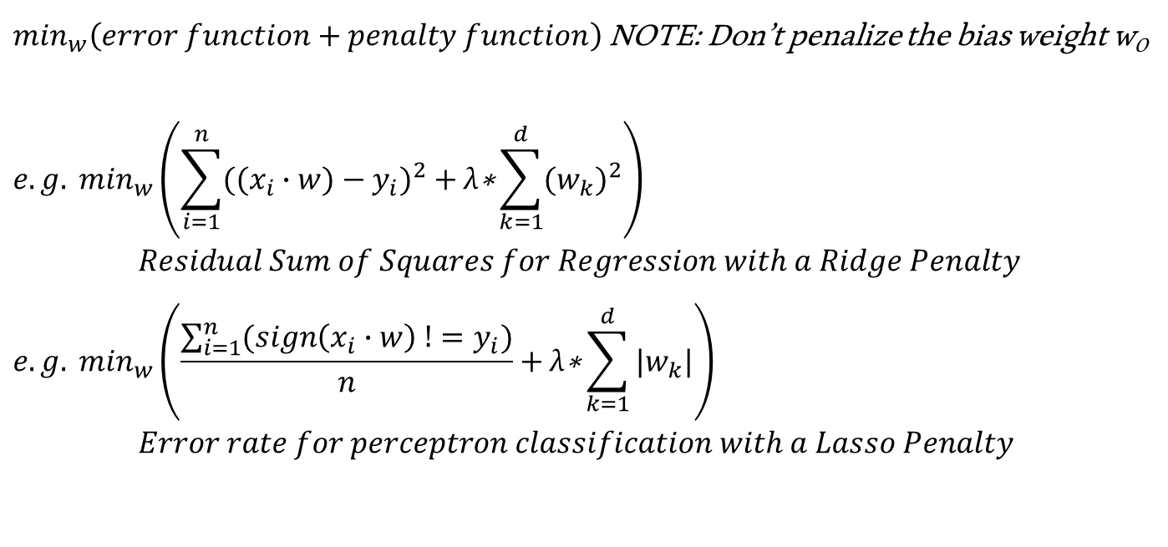
Optimizing Weights – Penalty Term
$\min_{w}\left(error function+penalty function\right)$ NOTE: Don’t penalize the bias weight w₀
$$e.g. \min_{w}\left(\sum_{i=1}^{n}{{((x_{i}∙w)−y_{i})}^{2}}+\text{λ}\text{∗}\sum_{k=1}^{d}{{(w_{k})}^{2}}\right)$$
$Residual Sum of Squares for Regression with a Ridge Penalty$
$$e.g. \min_{w}\left(\frac{\sum_{i=1}^{n}{(sign\left(x_{i}∙w\right) !=y_{i})}}{n}+\text{λ}\text{∗}\sum_{k=1}^{d}{|w_{k}|}\right)$$
$Error rate for perceptron classification with a Lasso Penalty$

Slide 153
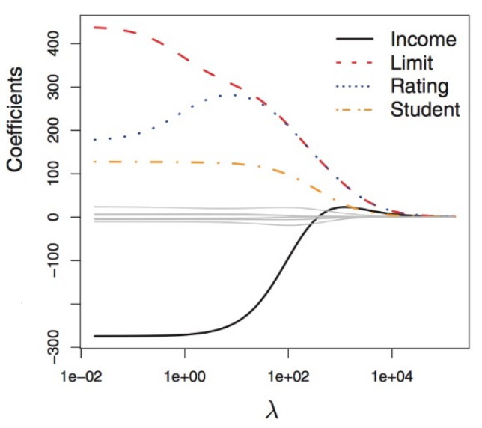
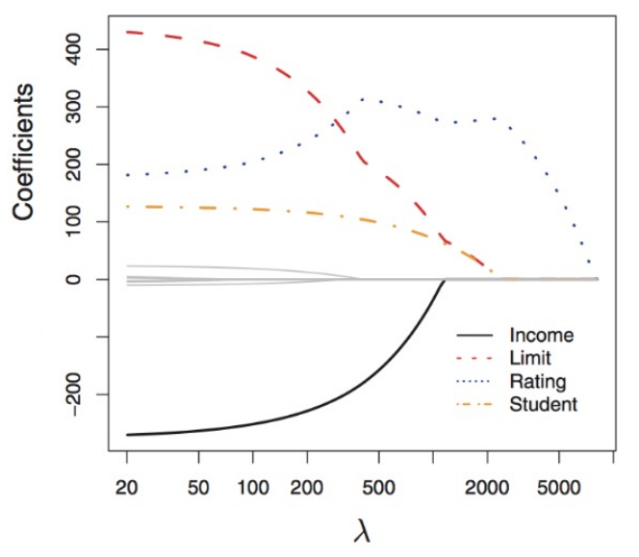
Model Behavior – Ridge vs. Lasso
Ridge Regression
- uniform converge
Lasso Regression
- different convergence
- collapses at 0

Slide 154
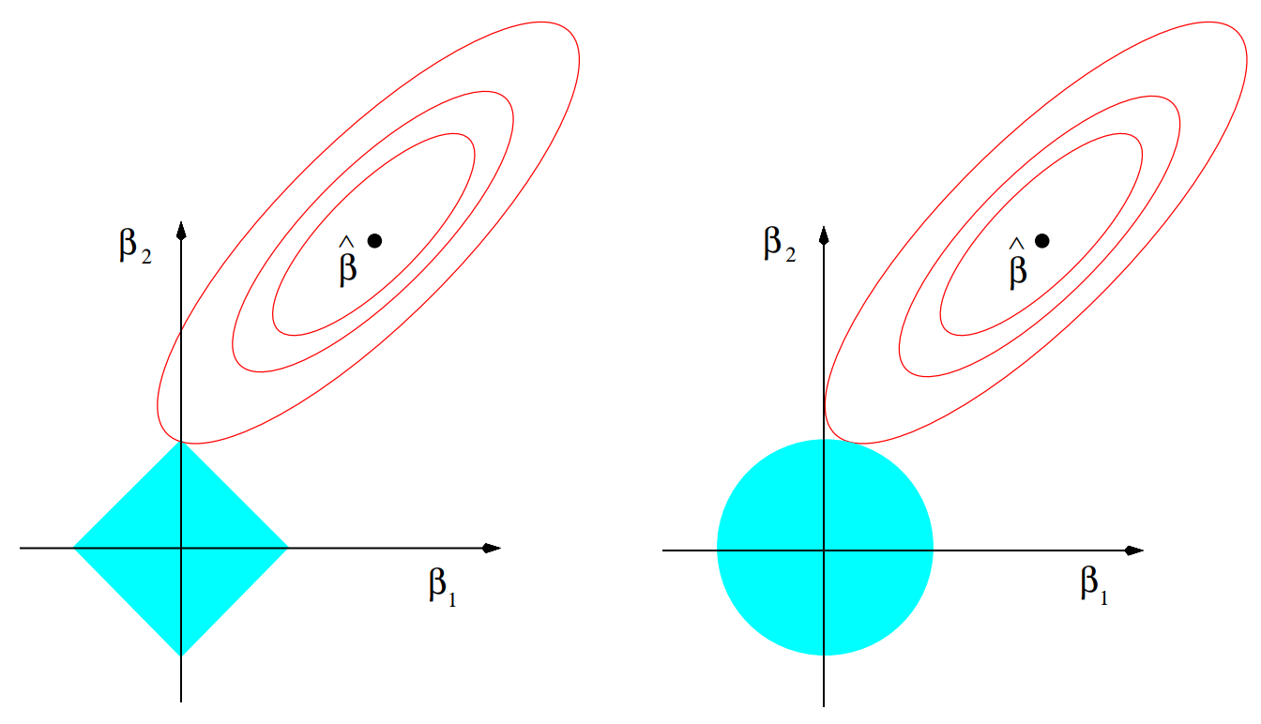
Understanding Model Behavior
Lasso Regression
In the 2D Case…
|w₁| + |w₂| <= s
Ridge Regression
In the 2D Case…
w²₁+ w²₂ <= s
Lasso Regression
min_{w}(||Y–Xw||²) such that
∑ _{k=1➔D}w²_{k} <= s (Ridge)
Ridge Regression
min_{w}(||Y–Xw||²) such that
∑ _{k=1➔D}|w_{k}| <= s (Lasso)

Slide 155
Ridge and Lasso In Practice

Slide 156

Exam 1 Topics Poll

Slide 157
Logistic Regression
Interlude

Slide 158

Our Problem Space – Dog Slobber
1 – Dog
0 - ~Dog
Slobber (ml)
Logistic Function p(X) = e^{w0+w1*X}
1 + e^{w0+w1*X}

Slide 159
Logistic Function
Logistic Function p(X) = e^{w0+w1*X} = 1
1 + e^{w0+w1*X} 1 + e ^{–(w0+w1*X)}

Slide 160
Logistic Regression – Holiday Example
What classification do we give x=[“Santa”, “Bad”]
x = [1, 1, 0, 0, 1, 0]
Feature | Bias | X₁ = “Santa” | X₂ = “Dreidel” | X₃ = “Christmas” | X₃ = “Bad” | X₄ = “Hate”
Weight | -0.1 | 10.0 | 15.0 | 12.0 | -2.0 | -4.0

Slide 161
Logistic Regression – Holiday Example
What classification do we give x=[“Santa”, “Bad”]
x = [1, 1, 0, 0, 1, 0]
w₀ + w₁ * x₁ + w₂ * x₂ + w₃ * x₃ + w₄ * x₄ + w₅ * x₅
-0.1 + 10.0 * 1 + 15.0 * 0 + 12.0 * 0 + -2.0 * 1 + -4.0 * 0 = +7.9
1 = 0.999… > 0.5 = Holiday Song!
1 + e ^{–(7.9)}
Feature | Bias | X₁ = “Santa” | X₂ = “Dreidel” | X₃ = “Christmas” | X₃ = “Bad” | X₄ = “Hate”
Weight | -0.1 | 10.0 | 15.0 | 12.0 | -2.0 | -4.0

Slide 162
Ridge and Lasso In Practice
(Within Logistic Regression)

Slide 163

Logistic Regression + Ridge & Lasso Penalty
We want to classify if our protagonist has currently gone Super Saiyan

Slide 164
Logistic Regression + Ridge & Lasso Penalty
We want to classify if our protagonist has currently gone Super Saiyan
What is our resulting Logistic Regression Probability for the following character’s Super Saiyan Status?
Hair Movement = 0.6, Eye to Head Height Ratio = 0.1
Feature | Bias | X₁ = Hair Movement | X₂ = Eye to Head Height Ratio
Weight | -1 | 5 | -7.5

Slide 165
Logistic Regression + Ridge & Lasso Penalty
We want to classify if our protagonist has currently gone Super Saiyan
What is our resulting Logistic Regression Probability for the following character’s Super Saiyan Status?
Hair Movement = 0.6, Eye to Head Height Ratio = 0.1
x = [1, 0.6, 0.1]
w₀ + w₁ * x₁ + w₂ * x₂
Feature | Bias | X₁ = Hair Movement | X₂ = Eye to Head Height Ratio
Weight | -1 | 5 | -7.5

Slide 166
Logistic Regression + Ridge & Lasso Penalty
We want to classify if our protagonist has currently gone Super Saiyan
What is our resulting Logistic Regression Probability for the following character’s Super Saiyan Status?
Hair Movement = 0.6, Eye to Head Height Ratio = 0.1
x = [1, 0.6, 0.1]
w₀ + w₁ * x₁ + w₂ * x₂
-1 + 5 * 0.6 + -7.5 * 0.1 = +1.25
1
1 + e ^{–(1.25)}
Feature | Bias | X₁ = Hair Movement | X₂ = Eye to Head Height Ratio
Weight | -1 | 5 | -7.5

Slide 167
Logistic Regression + Ridge & Lasso Penalty
We want to classify if our protagonist has currently gone Super Saiyan
What is our resulting Logistic Regression Probability for the following character’s Super Saiyan Status?
Hair Movement = 0.6, Eye to Head Height Ratio = 0.1
x = [1, 0.6, 0.1]
w₀ + w₁ * x₁ + w₂ * x₂
-1 + 5 * 0.6 + -7.5 * 0.1 = +1.25
1 = 0.777
1 + e ^{–(1.25)}
Feature | Bias | X₁ = Hair Movement | X₂ = Eye to Head Height Ratio
Weight | -1 | 5 | -7.5

Slide 168
Logistic Regression + Ridge & Lasso Penalty
We want to classify if our protagonist has currently gone Super Saiyan
1 = 0.777
1 + e ^{–(1.25)}
B) Given the probability of Super Saiyan calculated above, is our protagonist currently in this state?
Yes No

Slide 169
Logistic Regression + Ridge & Lasso Penalty
We want to classify if our protagonist has currently gone Super Saiyan
1 = 0.777
1 + e ^{–(1.25)}
B) Given the probability of Super Saiyan calculated above, is our protagonist currently in this state?
Yes No

Slide 170
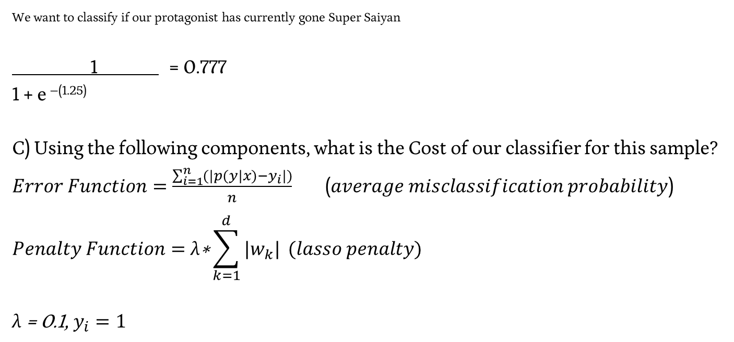
Logistic Regression + Ridge & Lasso Penalty
We want to classify if our protagonist has currently gone Super Saiyan
1 = 0.777
1 + e ^{–(1.25)}
C) Using the following components, what is the Cost of our classifier for this sample?
$Error Function=\frac{\sum_{i=1}^{n}{(|p(y|x)−y_{i}|)}}{n}$ ($average misclassification probability$)
$$Penalty Function=\text{λ}\text{∗}\sum_{k=1}^{d}{|w_{k}|} (lasso penalty)$$
$\text{λ}\text{ = 0.1, }y_{i}=1$
Feature | Bias | X₁ = Hair Movement | X₂ = Eye to Head Height Ratio
Weight | -1 | 5 | -7.5

Slide 171
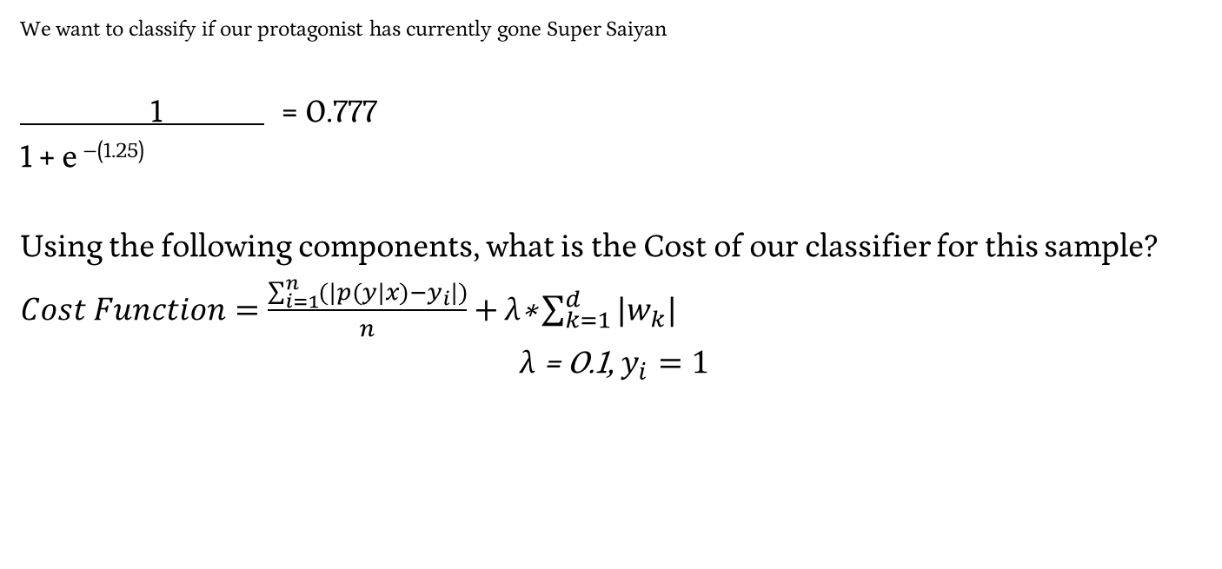
Logistic Regression + Ridge & Lasso Penalty
We want to classify if our protagonist has currently gone Super Saiyan
1 = 0.777
1 + e ^{–(1.25)}
Using the following components, what is the Cost of our classifier for this sample?
$Cost Function=\frac{\sum_{i=1}^{n}{(|p(y|x)−y_{i}|)}}{n}$ $+ \text{λ}\text{∗}\sum_{k=1}^{d}{|w_{k}|}$
$$\text{λ}\text{ = 0.1, }y_{i}=1$$
Feature | Bias | X₁ = Hair Movement | X₂ = Eye to Head Height Ratio
Weight | -1 | 5 | -7.5

Slide 172
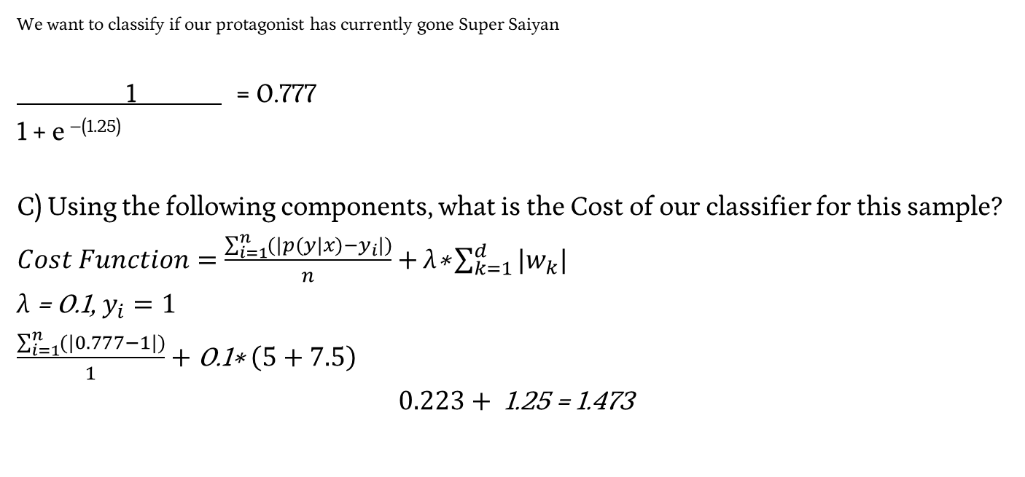
Logistic Regression + Ridge & Lasso Penalty
We want to classify if our protagonist has currently gone Super Saiyan
1 = 0.777
1 + e ^{–(1.25)}
C) Using the following components, what is the Cost of our classifier for this sample?
$Cost Function=\frac{\sum_{i=1}^{n}{(|p(y|x)−y_{i}|)}}{n}$ $+ \text{λ}\text{∗}\sum_{k=1}^{d}{|w_{k}|}$
$\text{λ}\text{ = 0.1, }y_{i}=1$
$\frac{\sum_{i=1}^{n}{(|0.777−1|)}}{1}$ $+ \text{0.1}\text{∗} \left(5+7.5\right)$
$$0.223+ \text{1.25 = 1.473}$$
Feature | Bias | X₁ = Hair Movement | X₂ = Eye to Head Height Ratio
Weight | -1 | 5 | -7.5

Slide 173
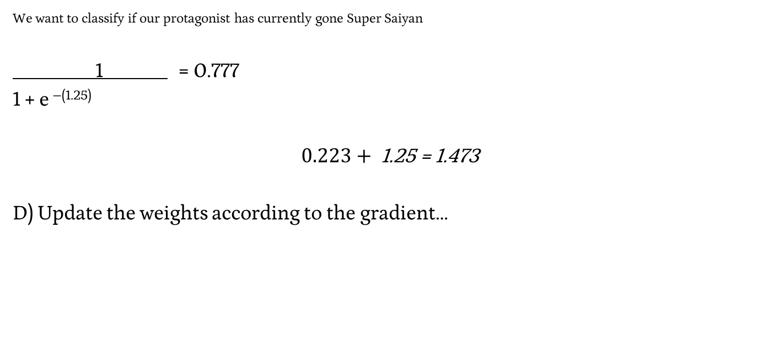

Logistic Regression + Ridge & Lasso Penalty
We want to classify if our protagonist has currently gone Super Saiyan
1 = 0.777
1 + e ^{–(1.25)}
$$0.223+ \text{1.25 = 1.473}$$
D) Update the weights according to the gradient…
Feature | Bias | X₁ = Hair Movement | X₂ = Eye to Head Height Ratio
Weight | -1 | 5 | -7.5

Slide 174

Exam 1 Topics Poll

Slide 175
SVMs

Slide 176
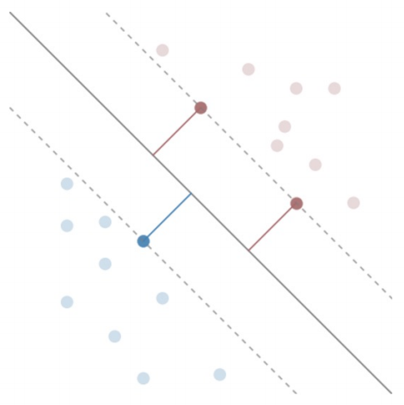
Best Decision Boundary
argmax_{w, b} (M) such that points are classified correctly
Support Vectors
w^{T}x + b = ± 1

Slide 177

Best Decision Boundary
Support Vectors
w^{T}x + b = ± 1

Slide 178
Maximizing our Margin
max_{α} (∑_{i} α_{i} − ½ ∑_{i,j} α_{i} α_{j} y_{i} y_{j} x_{i} · x_{j})
α_{i} > 0 if y_{i}(w^{T}x_{i} + b) = 1
α_{i} = 0 if y_{i}(w^{T}x_{i} + b) < 1

Slide 179
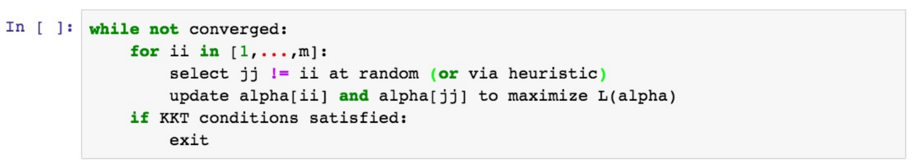
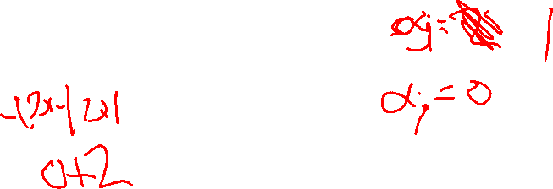

Sequential Minimal Optimizer
H if α_{j} > H
α_{j} = α_{j} if L <= α_{j} <= H
L if α_{j} < L
α_{i} such that α_{i} y_{i} + α_{j} y_{j} = - ∑_{k!=i,j} α_{k} y_{k} = δ

Slide 180
SVMs In Practice
A) Find the α values to create a maximum margin…
α | x1 | x2 | y
2 | 0.5 | -1.3 | 1
0 | -1.2 | 3 | -1
1 | -0.5 | 0.5 | -1
0 | 2 | -0.25 | 1

Slide 181
SVMs In Practice
Find the α values to create a maximum margin…
Perform Coordinate Ascent with…
Sample 0 and Sample 1
A Maximum α of 1
α | x1 | x2 | y
2 | 0.5 | -1.3 | 1
0 | -1.2 | 3 | -1
1 | -0.5 | 0.5 | -1
0 | 2 | -0.25 | 1

Slide 182
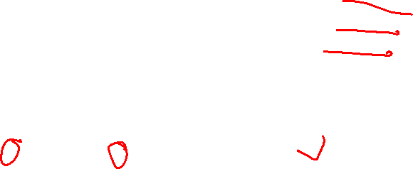
Exam 1 Topics Poll

Slide 183
Ensembles

Slide 184
Ensemble Methods
Build a bunch of dumb models on the training data
There are a bunch of ways to do this, stay tuned!
Feed our test data to all the models, get predictions
Take the best class from all of these models as our answer

Slide 185
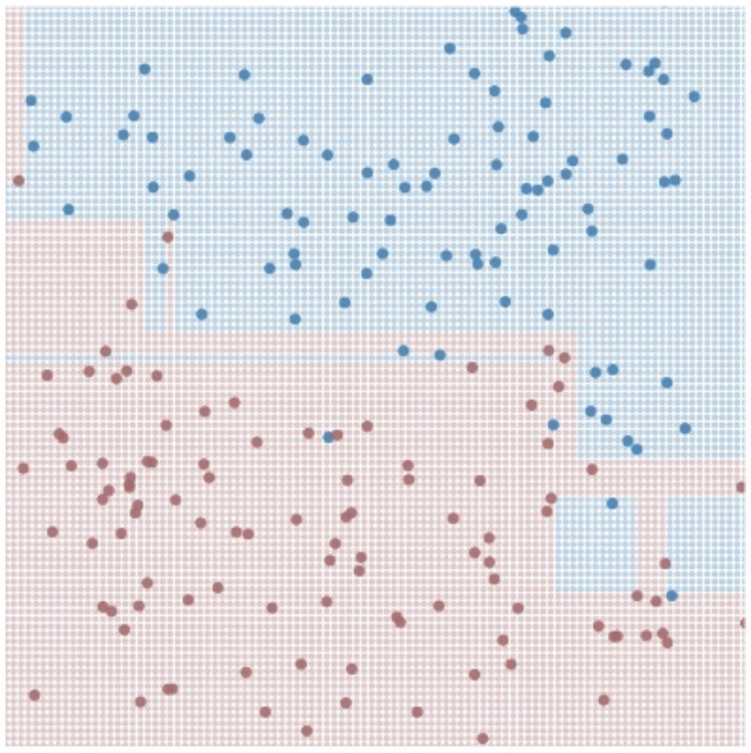
Building “Dumb” Models – Bagging (Bootstrap Aggregating)
TRAINING
For M (# Models) iterations:
Select N points with replacement
Train a decision tree
Hang on to that decision tree
TESTING
For each test point:
Ask all the decision trees what decision to make
Accept Y (the best answer)

Slide 186
Ensembles – In Practice
Given the following Training Data…
A) Perform a Bootstrap Resampling…
x1 | x2 | y
0.5 | -1.3 | 1
-1.2 | 3 | -1
-0.5 | 0.5 | -1
2 | -0.25 | 1

Slide 187
Ensembles – In Practice
Given the following Training Data…
A) Perform a Bootstrap Resampling…
x1 | x2 | y
0.5 | -1.3 | 1
-1.2 | 3 | -1
-0.5 | 0.5 | -1
2 | -0.25 | 1

Slide 188
Ensembles – In Practice
Given the following Resampled Training Data…
A) Build a depth = 1 tree…
x1 | x2 | y
0.5 | -1.3 | 1
-1.2 | 3 | -1
-0.5 | 0.5 | -1
2 | -0.25 | 1

Slide 189

Exam 1 Topics Poll

Slide 190
Bagging - Benefits
Reducing the variance (overfitting)
Variance – Sensitivity to the training set
Yes
Reducing the bias (underfitting)
Bias – Sensitivity to the model
No

Slide 191
Ensemble Methods– Random Forests
TRAINING
For M iterations:
Select N’ points with replacement
Train a decision tree:
For each split:
Choose F features to split on:
Choose your best split from them
Hang on to that decision tree
TESTING
For each test point:
Ask all the decision trees what decision to make
Accept Y

Slide 192
Ensembles – In Practice
Given the following Training Data…
Resample the data
and choose a random subset of variables…
x1 | x2 | y
0.5 | -1.3 | 1
-1.2 | 3 | -1
-0.5 | 0.5 | -1
2 | -0.25 | 1

Slide 193
Ensembles – In Practice
Given the following Training Data…
Resample the data
and choose a random subset of variables…
x1 | x2 | y
0.5 | -1.3 | 1
-1.2 | 3 | -1
-0.5 | 0.5 | -1
2 | -0.25 | 1

Slide 194
Ensembles – In Practice
Given the following Resampled Training Data…
A) Build a depth = 1 tree only using x1 as a feature
x1 | x2 | y
0.5 | -1.3 | 1
-1.2 | 3 | -1
-0.5 | 0.5 | -1
2 | -0.25 | 1

Slide 195
Ensemble Methods – A Weak Learner
Assumptions - binary classification problem
both classes are 50% likely
Expectations - A random guess model gets 50% accuracy
A “weak” learning model would perform slightly better than chance
We can only determine this through training accuracy / error

Slide 196
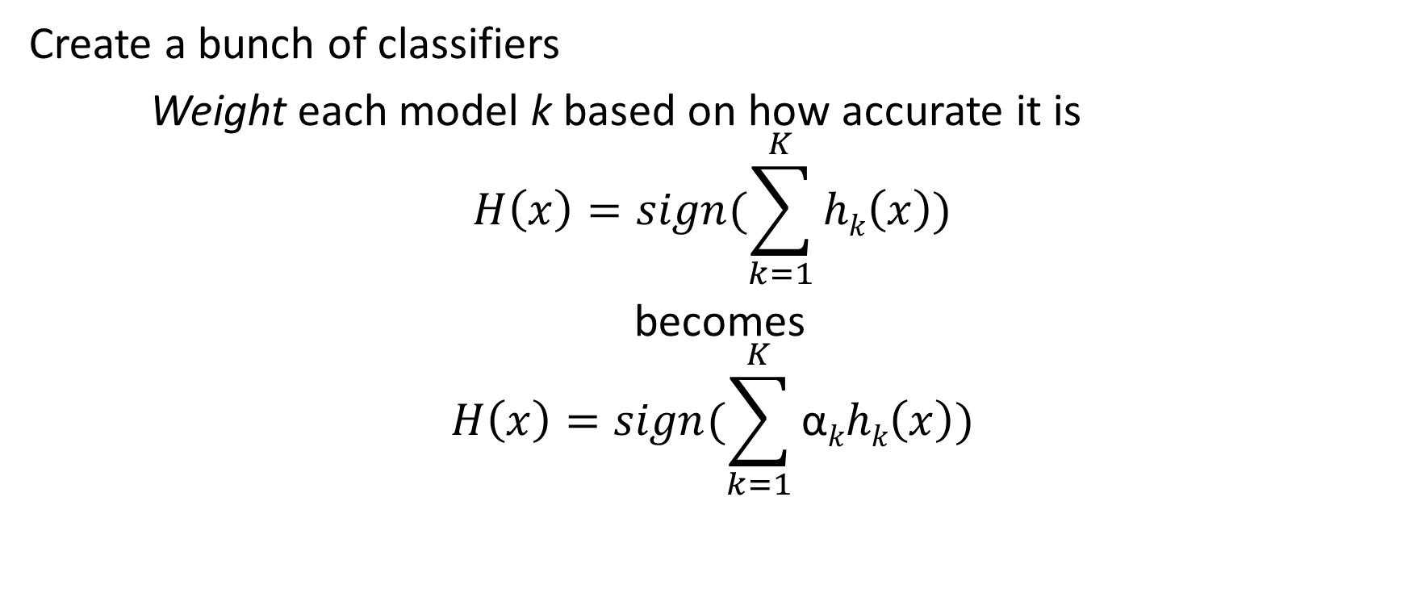
Boosting – Favoring Certain Points
Create a bunch of classifiers
Weight each model k based on how accurate it is
$$H\left(x\right)=sign(\sum_{k=1}^{K}{hk\left(x\right)})$$
becomes
$$H\left(x\right)=sign(\sum_{k=1}^{K}{\text{α}khk\left(x\right)})$$

Slide 197
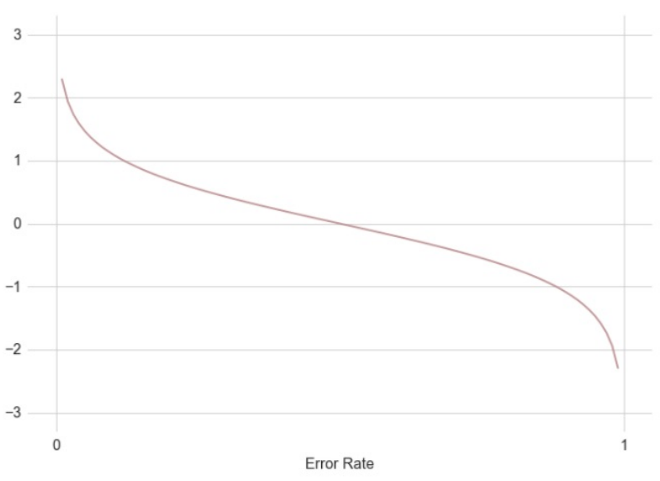
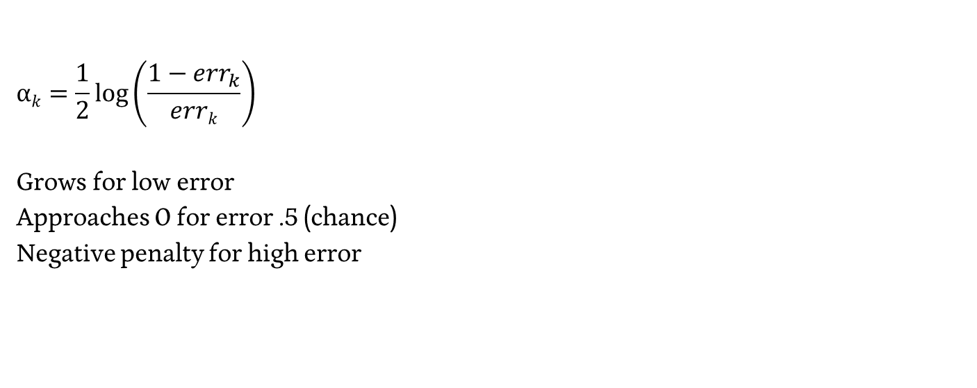
Exponential Weights for Individual Classifiers
$$\text{α}k=\frac{1}{2}\log\left(\frac{1−{err}_{k}}{errk}\right)$$
Grows for low error
Approaches 0 for error .5 (chance)
Negative penalty for high error

Slide 198
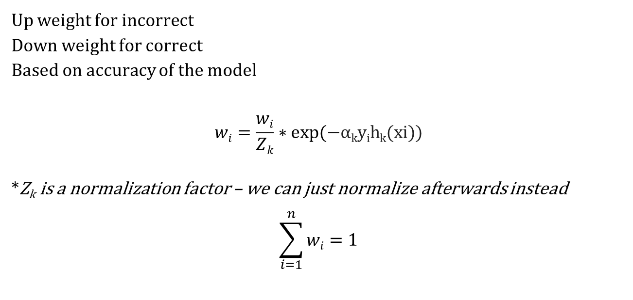
Updating our Weights - Adaboost
Up weight for incorrect
Down weight for correct
Based on accuracy of the model
$$wi=\frac{wi}{Zk}∗exp⁡(−\text{α}\text{k}\text{y}\text{i}\text{h}\text{k}\text{(}\text{xi}\text{))}$$
*Z_{k} is a normalization factor – we can just normalize afterwards instead
$$\sum_{i=1}^{n}{wi}=1$$

Slide 199
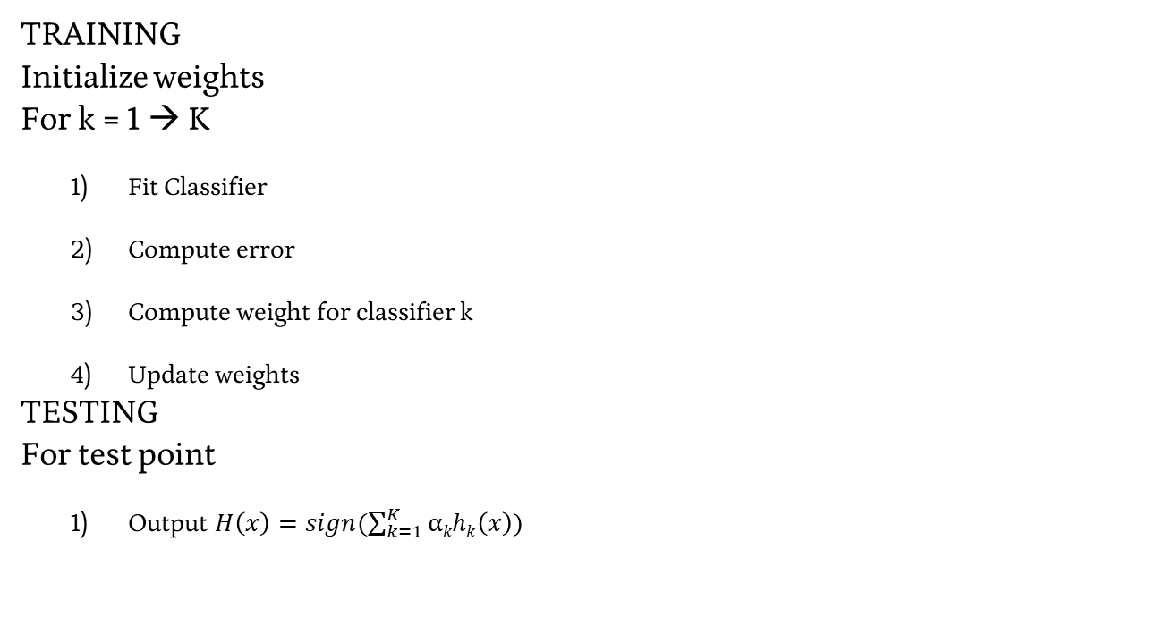
Adaboost in practice
TRAINING
Initialize weights
For k = 1 → K
Fit Classifier
Compute error
Compute weight for classifier k
Update weights
TESTING
For test point
Output $H\left(x\right)=sign(\sum_{k=1}^{K}{\text{α}khk\left(x\right)})$

Slide 200
Ensembles – In Practice
Given the following Training Data
A) Build an ensemble of 10 Adaboost models…
x1 | x2 | y
0.5 | -1.3 | 1
-1.2 | 3 | -1
-0.5 | 0.5 | -1
2 | -0.25 | 1

Slide 201
Ensembles – In Practice
Given the following Training Data
A) Build an ensemble of 10 Adaboost models…
x1 | x2 | y
0.5 | -1.3 | 1
-1.2 | 3 | -1
-0.5 | 0.5 | -1
2 | -0.25 | 1

Slide 202
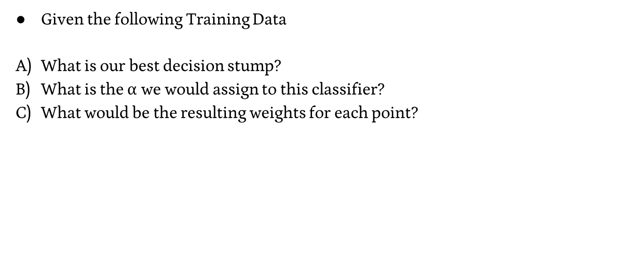
Ensembles – In Practice
Given the following Training Data
What is our best decision stump?
What is the $\text{α}$ we would assign to this classifier?
What would be the resulting weights for each point?
weight | x1 | x2 | y
.166 | 0.5 | -1.3 | 1
.166 | -1.2 | 3 | -1
.166 | -0.5 | 0.5 | -1
.166 | 2 | 0.6 | 1
.166 | -0.6 | 0.8 | 1
.166 | -0.9 | -0.4 | -1

Slide 203
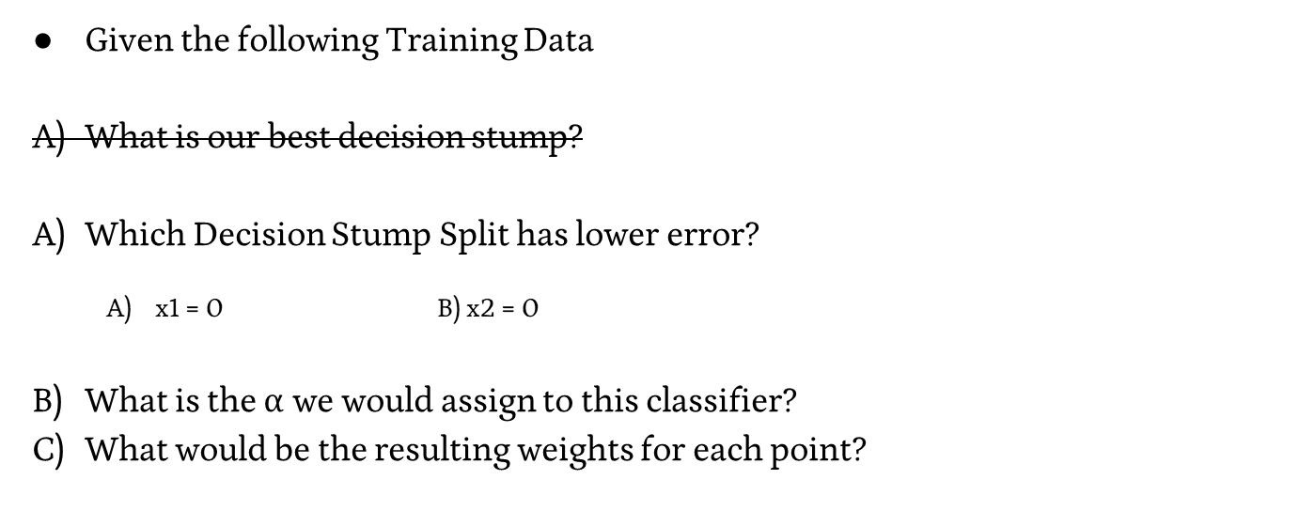
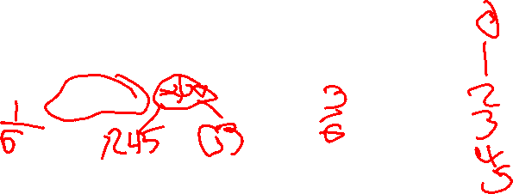
Ensembles – In Practice
Given the following Training Data
What is our best decision stump?
Which Decision Stump Split has lower error?
x1 = 0 B) x2 = 0
What is the $\text{α}$ we would assign to this classifier?
What would be the resulting weights for each point?
weight | x1 | x2 | y
.166 | 0.5 | -1.3 | 1
.166 | -1.2 | 3 | -1
.166 | -0.5 | 0.5 | -1
.166 | 2 | 0.6 | 1
.166 | -0.6 | 0.8 | 1
.166 | -0.9 | -0.4 | -1

Slide 204
Ensembles – In Practice
Given the following Training Data
What is our best decision stump?
Which Decision Stump Split has lower error?
x1 = 0 B) x2 = 0
What is the $\text{α}$ we would assign to this classifier?
What would be the resulting weights for each point?
weight | x1 | x2 | y
.166 | 0.5 | -1.3 | 1
.166 | -1.2 | 3 | -1
.166 | -0.5 | 0.5 | -1
.166 | 2 | 0.6 | 1
.166 | -0.6 | 0.8 | 1
.166 | -0.9 | -0.4 | -1

Slide 205
Exam 1 Topics Poll

Slide 206
Feature Selection

Slide 207
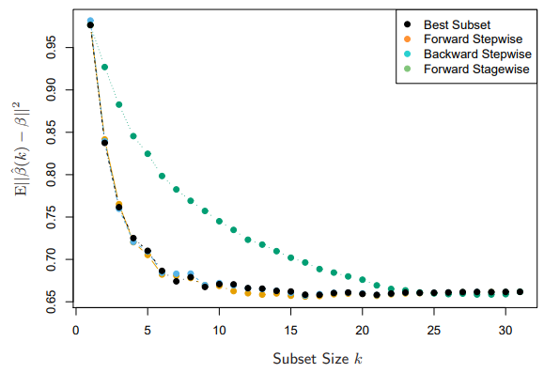
Feature Selection – Stepwise Selection
Forward-stepwise:
Start with an empty model,
add the most predictive
feature, rinse, repeat.
Backward-stepwise:
Start with a full model,
remove the least predictive
feature, rinse, repeat.

Slide 208
Curse of Dimensionality – Leave-one-out
Train & evaluate your classifier while leaving out one feature at a time.
MSE: 52K
Log Sq Ft | # Bedrooms | House Lat. | House Long. | Cost
3.2 | 4 | 121.33 | 47.34 | 500K
3.09 | 3 | 121.33 | 55.23 | 450K
2.87 | 2 | 121.33 | 55.34 | 200K
3.06 | 2 | 130.99 | 47.34 | 1500K

Slide 209
Curse of Dimensionality – Leave-one-out
Train & evaluate your classifier while leaving out one feature at a time.
MSE = 40K
Log Sq Ft | # Bedrooms | House Lat. | House Long. | Cost
3.2 | 4 | 121.33 | 47.34 | 500K
3.09 | 3 | 121.33 | 55.23 | 450K
2.87 | 2 | 121.33 | 55.34 | 200K
3.06 | 2 | 130.99 | 47.34 | 1500K

Slide 210
Curse of Dimensionality – Leave-one-out
Train & evaluate your classifier while leaving out one feature at a time.
MSE: 44K
Log Sq Ft | # Bedrooms | House Lat. | House Long. | Cost
3.2 | 4 | 121.33 | 47.34 | 500K
3.09 | 3 | 121.33 | 55.23 | 450K
2.87 | 2 | 121.33 | 55.34 | 200K
3.06 | 2 | 130.99 | 47.34 | 1500K

Slide 211
Curse of Dimensionality – Leave-one-out
Train & evaluate your classifier while leaving out one feature at a time.
MSE: 33K
Log Sq Ft | # Bedrooms | House Lat. | House Long. | Cost
3.2 | 4 | 121.33 | 47.34 | 500K
3.09 | 3 | 121.33 | 55.23 | 450K
2.87 | 2 | 121.33 | 55.34 | 200K
3.06 | 2 | 130.99 | 47.34 | 1500K

Slide 212
Curse of Dimensionality – Leave-one-out
Train & evaluate your classifier while leaving out one feature at a time.
MSE: 52K
Removing Log Sq Ft made our MSE much worse!
Log Sq Ft | # Bedrooms | House Lat. | House Long. | Cost
3.2 | 4 | 121.33 | 47.34 | 500K
3.09 | 3 | 121.33 | 55.23 | 450K
2.87 | 2 | 121.33 | 55.34 | 200K
3.06 | 2 | 130.99 | 47.34 | 1500K

Slide 213
Curse of Dimensionality – Leave-one-out
Train & evaluate your classifier while leaving out one feature at a time.
MSE: 33K
Removing Longitude had the least effect on my MSE!
Log Sq Ft | # Bedrooms | House Lat. | House Long. | Cost
3.2 | 4 | 121.33 | 47.34 | 500K
3.09 | 3 | 121.33 | 55.23 | 450K
2.87 | 2 | 121.33 | 55.34 | 200K
3.06 | 2 | 130.99 | 47.34 | 1500K

Slide 214
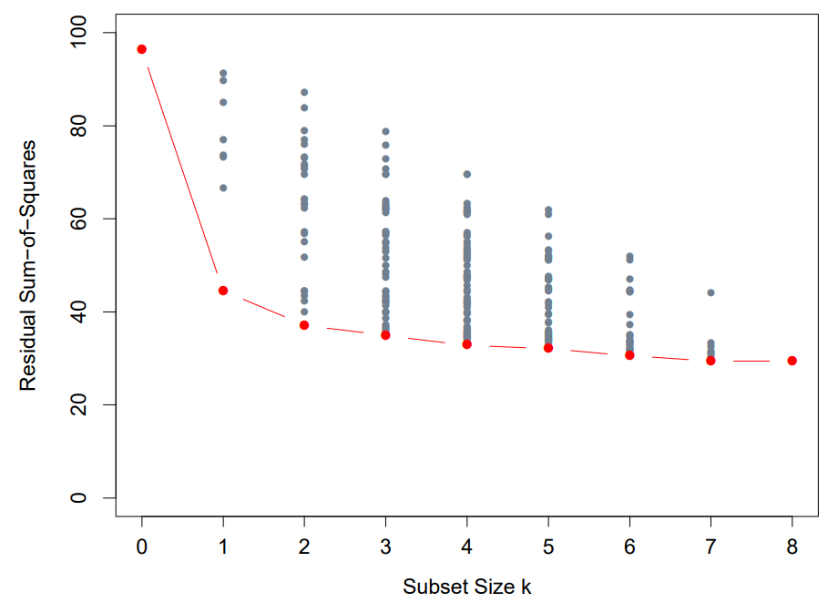

Feature Selection – Best Subset
Choose the k feature set
size you want
Create all subsets of size k
Find the RSS minimization
for your subset

Slide 215
Exam 1 Topics Poll

Slide 216
Measuring Goodness

Slide 217
Measuring Goodness
Classification

Slide 218
Calculating Errors
Error = 1/n * ∑_{i=1→n}(I(ŷ_{i} ≠ y_{i}))
# errors / # instances

Slide 219
Types of Errors
# errors / # instances
Classified As Ground Truth | C | ~C
C | 8 | 2
~C | 3 | 7

Slide 220
Types of Errors
Predicted Positive Rate (Precision) = Hits / (Hits + False Alarm)
Classified As Ground Truth | C | ~C
C | True Positive (Hit) | False Negative (Miss)
~C | False Positive (False Alarm) | True Negative (Correct Rejection)

Slide 221
Types of Errors
Predicted Positive Rate (Precision) = Hits / (Hits + False Alarm)
Classified As Ground Truth | C | ~C
C | 8 | 2
~C | 3 | 7

Slide 222
Types of Errors
Predicted Negative Rate (Negative Predictive Value) = Corr. Rej / (Miss + Corr. Rej.)
Classified As Ground Truth | C | ~C
C | True Positive (Hit) | False Negative (Miss)
~C | False Positive (False Alarm) | True Negative (Correct Rejection)

Slide 223
Types of Errors
Predicted Negative Rate (Negative Predictive Value) = Corr. Rej / (Miss + Corr. Rej.)
Classified As Ground Truth | C | ~C
C | 8 | 2
~C | 3 | 7

Slide 224
Types of Errors
True Positive Rate (Sensitivity, Recall) = Hits / (Hits + Miss)
Classified As Ground Truth | C | ~C
C | True Positive (Hit) | False Negative (Miss)
~C | False Positive (False Alarm) | True Negative (Correct Rejection)

Slide 225
Types of Errors
True Positive Rate (Sensitivity, Recall) = Hits / (Hits + Miss)
Classified As Ground Truth | C | ~C
C | 8 | 2
~C | 3 | 7

Slide 226
Types of Errors
1 - False Positive Rate (Specificity) = Corr. Rej. / (False Alarm + Corr. Rej.)
Classified As Ground Truth | C | ~C
C | True Positive (Hit) | False Negative (Miss)
~C | False Positive (False Alarm) | True Negative (Correct Rejection)

Slide 227
Types of Errors
1 - False Positive Rate (Specificity) = Corr. Rej. / (False Alarm + Corr. Rej.)
Classified As Ground Truth | C | ~C
C | 8 | 2
~C | 3 | 7

Slide 228

Errors – F1 Score
The “Harmonic Mean” of Precision and Recall
$$2∗\frac{Precision ∗Recall}{Precision+Recall}$$
$$Precision=\frac{Hits}{Hits+False Alarms}$$
$$Recall= \frac{Hits}{Hits+Misses}$$
https://en.wikipedia.org/wiki/F-score

Slide 229

Errors – F1 Score
The “Harmonic Mean” of Precision and Recall
$$2∗\frac{Precision ∗Recall}{Precision+Recall}$$
$$F1= \frac{tp}{tp+ .5(fp+fn)}$$
https://en.wikipedia.org/wiki/F-score

Slide 230


Classification Errors – ROC Curve (receiver operating characteristic)
Notes:
https://www.medcalc.org/manual/roc-curves.php

Slide 231
Measuring Goodness
Regression

Slide 232

Residual Sum of Squares
RSS(w) = ||Y – Xw||² = ∑_{i=1→m} (y_{i} – w ∙ x_{i})²
We’re looking for the least-squares solution
Notes:
https://uc-r.github.io/public/images/analytics/regression/sq.errors-1.png

Slide 233


Regression Error
Accuracy = # correct / # total – Does not capture “close”…
What’s the difference between our ground truth and our prediction?
Absolute Error - $\sum_{n}^{1}{\left|y_{i}−{\overline{y}}_{i}\right|}$
What’s the average distance between our ground truths and predictions?
Mean Absolute Error - $\frac{\sum_{n}^{1}{\left|y_{i}−{\overline{y}}_{i}\right|}}{n}$
What’s the average squared distance (we’ll get more into why later)
Mean Squared Error - $\frac{\sum_{n}^{1}{{\left(y_{i}−{\overline{y}}_{i}\right)}^{2}}}{n}$

Slide 234
Reporting goodness using RSS
RSS is a general notion of goodness of fit
Transformations of RSS get us to a notion like accuracy
- “I have 95% confidence that I am within $5,000 of offer price”
- “I have 95% confidence that I am within 5,000 miles of home”
We shouldn’t need to interpret appropriate goodness for each problem

Slide 235
Developing goodness – a baseline
Yuma weather: sunny = True - 84 % Accuracy
- Using no features, I simply predict the majority label
Can we do a similar thing with a regression problem?
House Cost = <the average cost of a house>

Slide 236
Developing goodness – a baseline
Baseline (Total Sum of Squares) = ||Y–avg(Y)||²
Our Error (Residual Sum of Squares) = ||Y–Xw||²
Improvement: ||Y–Xw||² vs ||Y–avg(Y)||²

Slide 237
Developing goodness – coefficient of determination R²
Baseline (Total Sum of Squares) = ||Y–avg(Y)||²
Our Error (Residual Sum of Squares) = ||Y–Xw||²
Improvement: ||Y–Xw||² vs ||Y–avg(Y)||²
R² = 1 – RSS/TSS

